Slide 1



Sensor Integrity in Machine Learning: Toward Building Robust Systems against Cyberattacks.
Ade Kurniawan
3rd IEEE International Conference on AI in Cybersecurity (ICAIC)
7-9 February 2024
University of Houston, 4800 Calhoun Rd, Houston, TX 77004
Notes:
Respected Professors Masayuki Murata, Hirozumi Yamaguchi, Toru Hasegawa, Hideyuki Shimonishi, and Takashi Watanabe,
I am profoundly honored and grateful for the opportunity to present my thesis, titled "Network Forensics of Ransomware and Sensor Integrity in Machine Learning: Toward Building Robust Systems against Cyberattacks.
Thank you for your time, support and the opportunity to share my work with you today.

Slide 2
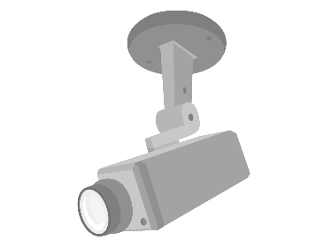

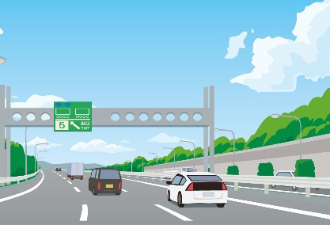
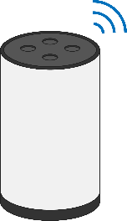
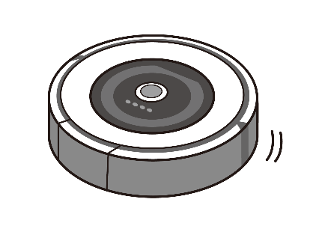
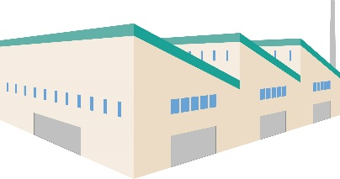
Machine Learning
security
Medical
Smart Factories
Autonomous driving
Appliances in the home

Slide 3

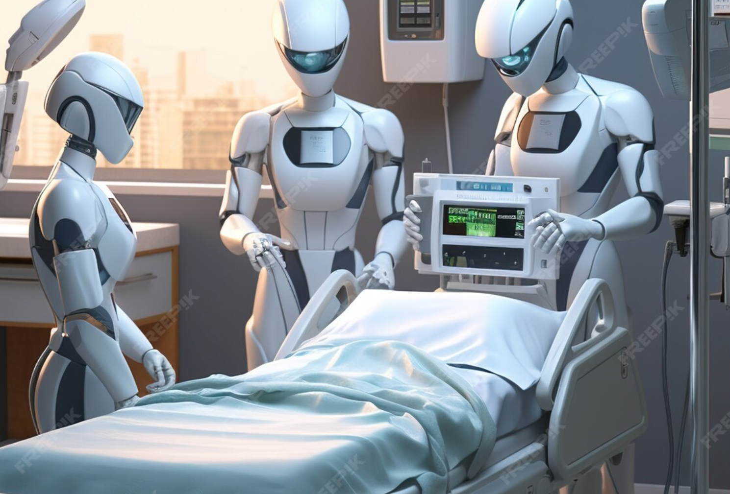
Introduction
1. Importance of multi-sensor ML systems:
  ML with sensors improves accuracy in applications like healthcare and self-driving cars.
  Combining data from multiple sensors enhances recognition capabilities.

Slide 4

Impact of Machine Learning Attacks
Disruption of rival companies
Demanding money from AI as a hostage
terrorism
2. Vulnerability to adversarial examples (AEs):
Malicious actors can create AEs to manipulate ML system predictions.
AEs can attack physical objects and deep learning systems in critical areas.
security
Smart Factories
Medical
Autonomous driving
Appliances in the home
Decline in the value of goods
Disable security
↓
Physical intrusion
Makes it possible
Shutting down the factory
Wrong diagnosis.
Occurrence of serious accidents

Slide 5




Target Attack Class: Lying Down
Machine Learning
Target Attack Class: Lying Down
Actual Class: Running
3. Sensor-based AEs in multi-sensor systems:
  Sensor vulnerabilities can be exploited for AE attacks.
  Data tampering through software or hardware modifications is possible.
  Manipulating some sensor readings can impact ML model outputs.
Can I alter the output of an ML model by hacking just a small number of sensors?
2/7/2024
5

Slide 6


どもありがとうございます
4. Proactive strategy for robustness :
  Introducing redundancy with additional sensors can counter sensor-based AEs.
  We need a metric to measure system redundancy against AE attacks.
Thank you
2/7/2024
6

Slide 7

5. Challenges in protecting against sensor-based AEs:
  Protecting all sensors becomes increasingly difficult with more sensors.
  Reactive defense methods might not work if critical sensors are compromised

Slide 8

どもありがとうございます
6. Proposed solution:
  Define groups of sensors potentially vulnerable to the same attacker.
  Develop a "criticality" metric to measure sensor group importance for class distinction.
  Interactively add sensors to decrease criticality and boost robustness against AEs.
Thank you
2/7/2024
8

Slide 9
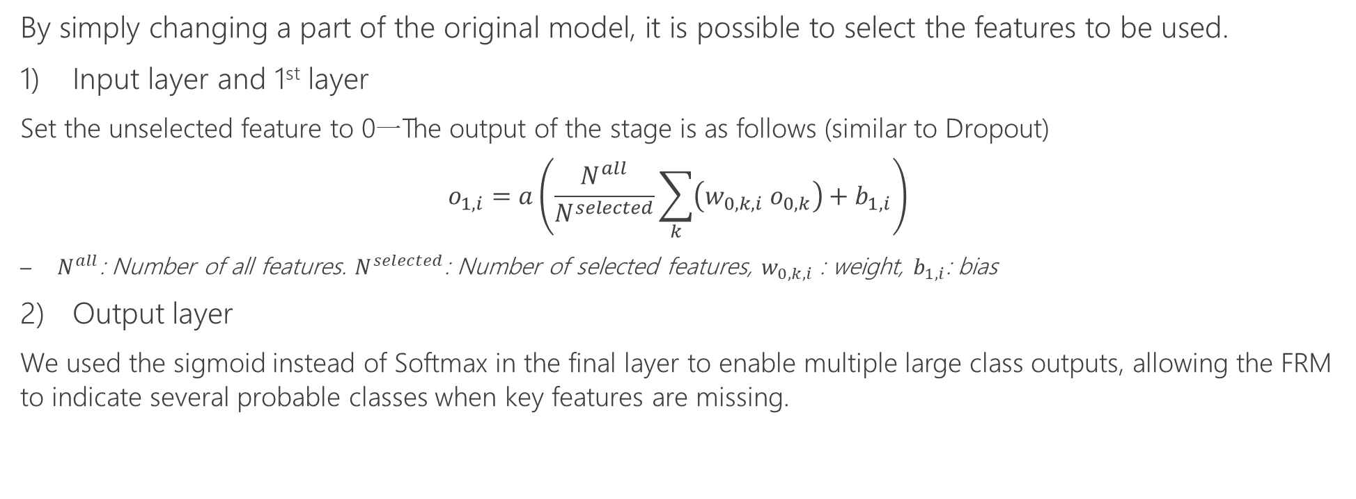
Training Feature Removable Model[1]
1st layer
original model
Final layer
feature-removable model (FRM)
By simply changing a part of the original model, it is possible to select the features to be used.
Input layer and 1st layer
  Set the unselected feature to 0一The output of the stage is as follows (similar to Dropout)
  $$o_{1,i}=a\left(\frac{N^{all}}{N^{selected}}\sum_{k}{\left(w_{0,k,i} o_{0,k}\right)+b_{1,i}}\right)$$
    $N^{all}$: Number of all features. $N^{selected}$: Number of selected features, $w_{0,k,i}$ : weight, $b_{1,i}$: bias
Output layer
  We used the sigmoid instead of Softmax in the final layer to enable multiple large class outputs, allowing the FRM to indicate several probable classes when key features are missing.
2/7/2024
9
[1] Kurniawan, A.; Ohsita, Y.; Maisuria, S.; Murata, M. Detection of Sensors Used for Adversarial Examples against Machine Learning Models. Preprints 2023, 2023110328. https://doi.org/10.20944/preprints202311.0328.v1

Slide 10
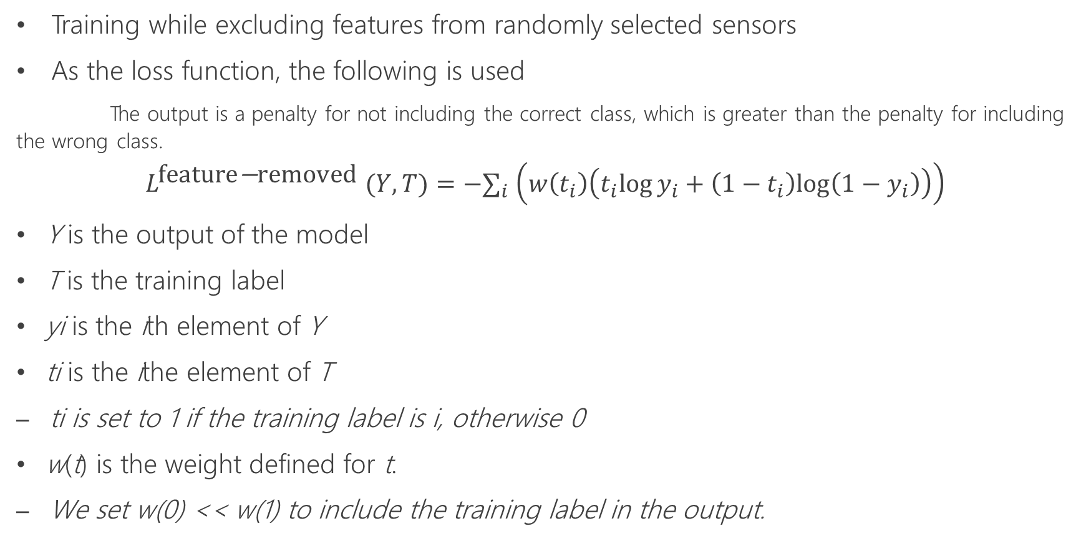
Training Feature Removable Model (FRM)
Training while excluding features from randomly selected sensors
As the loss function, the following is used
      The output is a penalty for not including the correct class, which is greater than the penalty for including the wrong class.
$$L^{\text{feature}\text{−}\text{removed} }(Y,T)=−∑_{i} \left(w\left(t_{i}\right)\left(t_{i}log⁡y_{i}+\left(1−t_{i}\right)log⁡\left(1−y_{i}\right)\right)\right)$$
  Y is the output of the model
  T is the training label
  yi is the ith element of Y
  ti is the ithe element of T
    ti is set to 1 if the training label is i, otherwise 0
  w(t) is the weight defined for t.
    We set w(0) << w(1) to include the training label in the output.

Slide 11




output
(Current Actions)
Standing still
Sitting
Lying down
Walking
Climbing stairs
Waist bends forward Frontal elevation of arms Knees bending
Cycling
Jogging
Running
Jump front & back
Training FRM
Input
Outputs
(Current Actions)
Standing still
Sitting
Lying down
Walking
Climbing stairs
Waist bends forward
Frontal elevation of arms
Knees bending
Cycling
Jogging
Running
Jump front & back
Machine learning model
Wrist, chest, and ankle sensors.
3-axis acceleration, 3-axis angular velocity, 3-axis magnetic, and heart rate
Dataset: mHealth http://archive.ics.uci.edu/ml/datasets/mhealth+dataset)

Slide 12
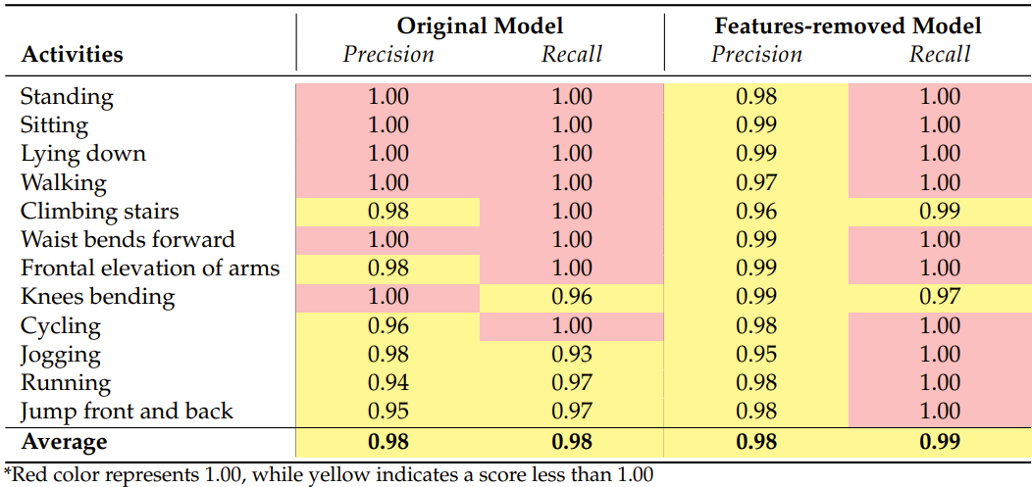
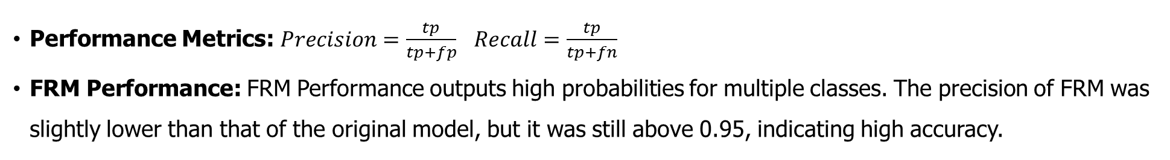
Property of the FRM
Performance Metrics: $Precision=\frac{tp}{tp+fp}$ $Recall=\frac{tp}{tp+fn}$
  FRM Performance: FRM Performance outputs high probabilities for multiple classes. The precision of FRM was slightly lower than that of the original model, but it was still above 0.95, indicating high accuracy.
Notes:
The properties of the FRM were compared to the original model to understand its performance.
Performance Metrics: Precision and Recall are used as metrics, defined as: $Precision=\frac{tp}{tp+fp}$ $Recall=\frac{tp}{tp+fn}$
where tp (true positives) are correct identifications, and fp (false positives) are incorrect identifications of the target class. where fn (false negatives) are instances where the actual class is the target class, but it is not identified as such.
FRM Performance: The FRM can output high probabilities for multiple classes. Precision for FRM is slightly lower than the original model due to this allowance, but it is still above 0.95, indicating high accuracy

Slide 13
Defining Criticality
Reactive Defense and Sensor Limitations;
  Reactive sensor-based methods are less effective when key sensors for state distinction are compromised.
Redundancy's Role:
  Redundancy in systems helps maintain functionality despite compromised sensors, highlighting the need for a redundancy assessment metric.

Slide 14
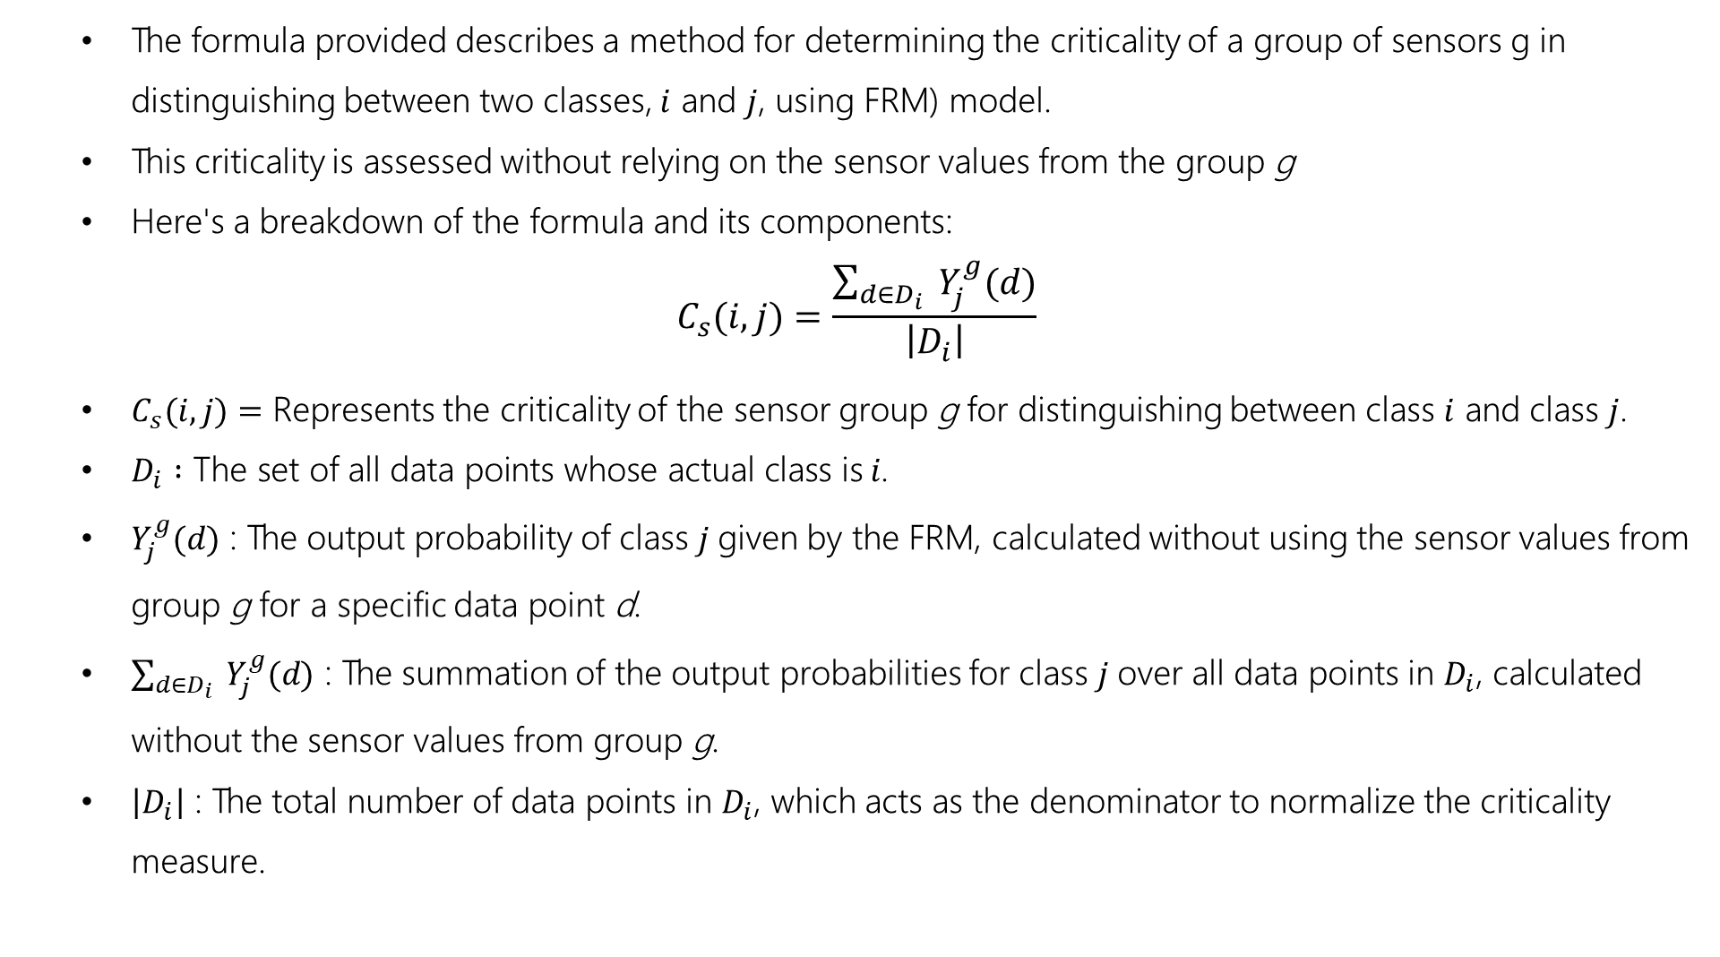
Criticality Metric of Sensors
  The formula provided describes a method for determining the criticality of a group of sensors g in distinguishing between two classes, $i$ and $j$, using FRM) model.
  This criticality is assessed without relying on the sensor values from the group g
  Here's a breakdown of the formula and its components:
$$C_{s}(i,j)=\frac{\sum_{d∈D_{i}}{ }Y_{j}^{g}(d)}{\left|D_{i}\right|}$$
  $C_{s}(i,j)=$ Represents the criticality of the sensor group g for distinguishing between class $i$ and class $j$.
  $D_{i} :\text{The} \text{set} \text{of} \text{all} \text{data} \text{points} \text{whose} \text{actual} \text{class} \text{is} i\text{.}$
  $Y_{j}^{g}(d)$ : The output probability of class $j$given by the FRM, calculated without using the sensor values from group g for a specific data point d.
  $\sum_{d∈D_{i}}{ }Y_{j}^{g}(d)$ : The summation of the output probabilities for class $j$over all data points in $D_{i}$, calculated without the sensor values from group g.
  $\left|D_{i}\right|$ : The total number of data points in $D_{i}$​, which acts as the denominator to normalize the criticality measure.

Slide 15
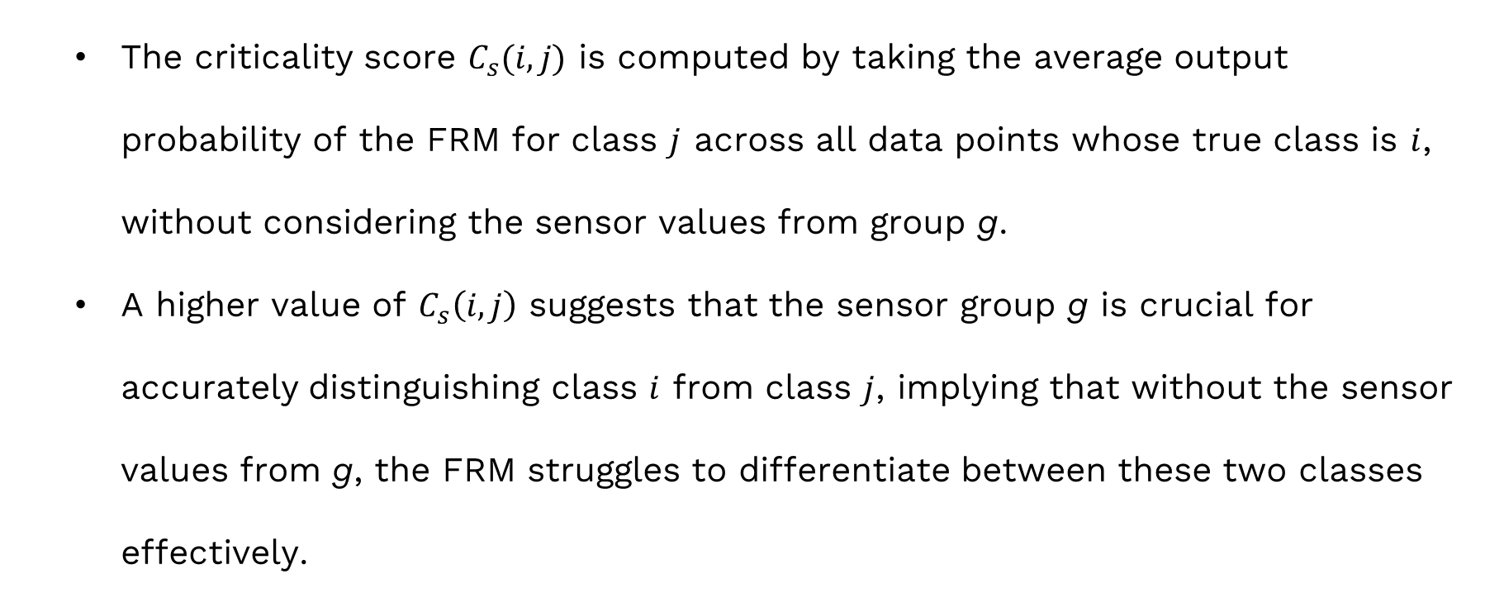
Criticality Metric of Sensors
  The criticality score $C_{s}(i,j)$ is computed by taking the average output probability of the FRM for class $j$ across all data points whose true class is $i$, without considering the sensor values from group g.
  A higher value of $C_{s}\left(i,j\right)$ suggests that the sensor group g is crucial for accurately distinguishing class $i$ from class $j$, implying that without the sensor values from g, the FRM struggles to differentiate between these two classes effectively.

Slide 16
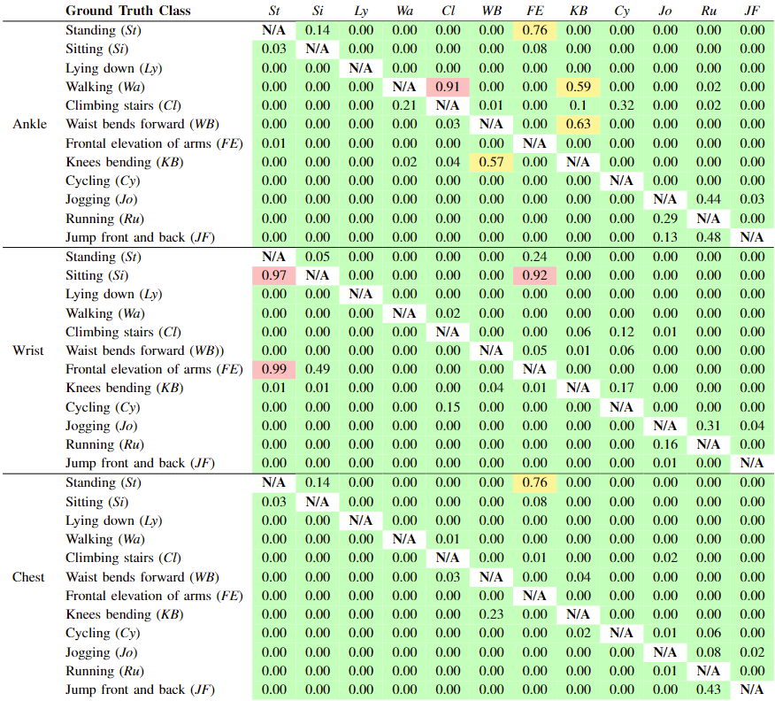
Criticality of Sensors
While most activities retained accurate classification with a single sensor missing, specific sensors like ankle (walking) and wrist (sitting) were crucial for certain activities.
This highlights vulnerabilities and the importance of redundancy for continued functionality despite compromised sensors.
Understanding criticality is crucial for defense, enabling effective strategies.
The criticality of each sensor device for each class pair

Slide 17
どもありがとうございます
Thank you
どもありがとうございます
2/7/2024
17

