Slide 1



Network Forensics of Ransomware and Sensor Integrity in Machine Learning:
Toward Building Robust Systems against Cyberattacks.
Ade Kurniawan
Notes:
Respected Professors Masayuki Murata, Hirozumi Yamaguchi, Toru Hasegawa, Hideyuki Shimonishi, and Takashi Watanabe,
I am profoundly honored and grateful for the opportunity to present my thesis, titled "Network Forensics of Ransomware and Sensor Integrity in Machine Learning: Toward Building Robust Systems against Cyberattacks.
Thank you for your time, support and the opportunity to share my work with you today.

Slide 2
1
Chapter

Slide 3

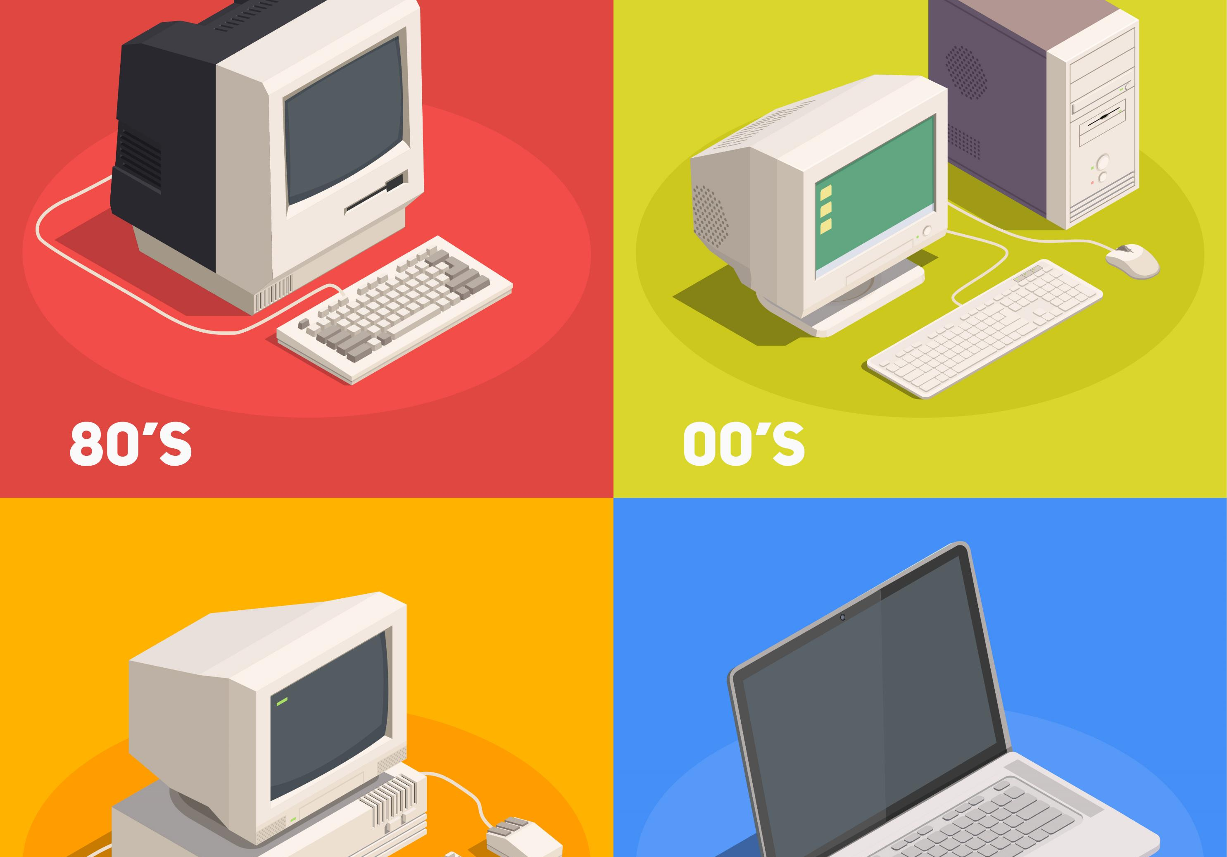

Integration of PCs, AI, and Networks
Notes:
Tech Revolution: 3 Key Components
PCs: Evolved from data processors to hubs for communication, entertainment, and information.
Sensors: Transformed from simple tools to sophisticated instruments capturing complex life data.
AI: Bloomed from a theoretical concept into a powerful technology for learning, decision-making, and even mimicking human thought.
Together, they reshape our interaction with the world.

Slide 4

Cybersecurity Threats
Cybersecurity Threats:
Importance due to the critical role of information technologies.
Major concerns include economic loss, reputation damage, and safety risks
An example of malware cyber attacks.
2017 NHS cyberattack - exploited Windows vulnerabilities, affected 200,000+ computers in 150 countries.

Slide 5

To strengthen defense, it is important to understand how Malware spreads and reconstructs a chain of events. reconstructs

Slide 6

Shifting Information Systems: From traditional (servers, PCs, smartphones) to machine learning (ML) models.
Enhanced Safety & Efficiency: ML optimizes operations in healthcare, agriculture, and beyond.
Future Potential: Wider applications, deeper integration, and robustness of AI,

Slide 7
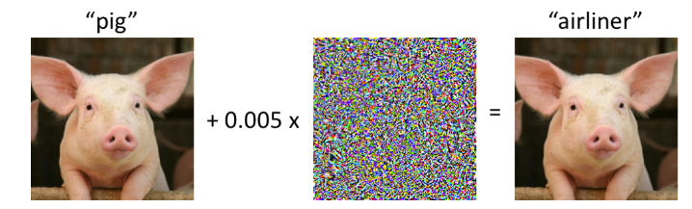
Adversarial Examples:
[1]
AEs as a significant vulnerability in machine learning models.
Manipulation of input data to mislead ML predictions.
It is important to protect ML models and sensors against these attacks.
[1] A. Madry, A. Makelov, L. Schmidt, D. Tsipras, and A. Vladu, “Towards Deep Learning Models Resistant to Adversarial Attacks,” 6th Int. Conf. Learn. Represent. ICLR 2018 - Conf. Track Proc., pp. 1–28, Jun. 2017, [Online]. Available: http://arxiv.org/abs/1706.06083
Notes:
ML systems face cyber threats, including adversarial examples that can manipulate input data and skew predictions. Fortifying ML models against these attacks is essential for robust cybersecurity

Slide 8




Target Attack Class: Lying Down
Machine Learning
Target Attack Class: Lying Down
Actual Class: Running
Can I alter the output of an ML model by hacking just a small number of sensors?
Traditional assumptions vs. new approach: Hacking a few sensors
The scenario of partial sensor hacking
Experiment with the human activity recognition model
Goals: Feasibility of attacks with limited sensor control
Notes:
We explore the impact of manipulating a small number of sensors on machine learning models. We demonstrate how tampering with specific sensors can alter ML model outputs in a human activity recognition scenario.

Slide 9
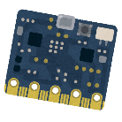

Detection of Compromised Sensors in ML Systems:
Inputs
Output
Countermeasure
Actual label
Protecting every sensor is impractical.
Importance of identifying vulnerable sensors.
Introduction of Feature-Removable Model (FRM)
Method to detect sensors used by attackers in AEs.
Notes:
Protecting every sensor is impractical, so we propose a novel strategy to safeguard ML models even with compromised sensors. Our approach identifies manipulated sensors by analyzing inconsistencies in model outputs, enabling inspection and replacement.**

Slide 10
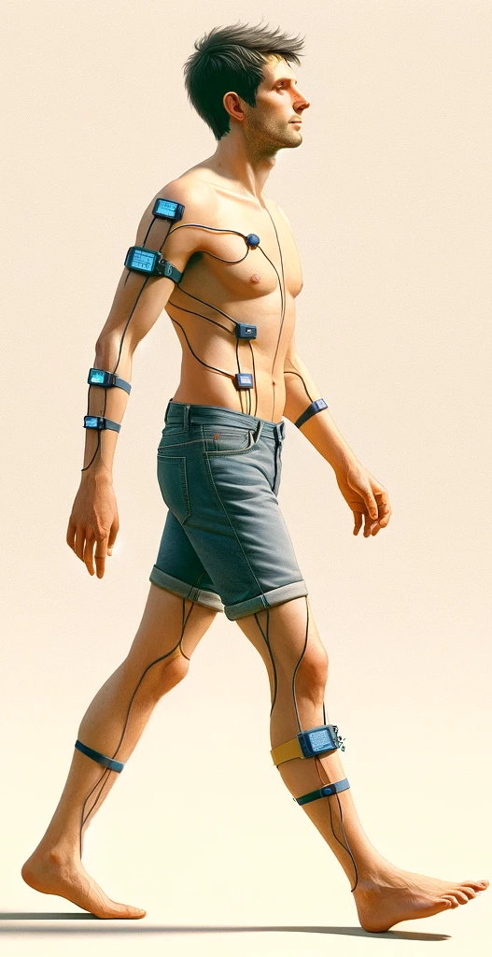
Enhancing System Robustness Against Sensor-Based AEs:
Strategy for proactive system robustness
Redundancy and the role of sensor criticality
Defining critical sensor groups using FRM
Goal to reduce criticality and enhance system resilience
Walking / Running
Notes:
This thesis proposes a proactive approach to sensor-based AE robustness. By leveraging redundancy, systems can function despite compromised sensors. We define sensor groups vulnerable to an attacker and assess their criticality for classifying classes. We then add sensors interactively, reducing criticality and enhancing robustness.

Slide 11

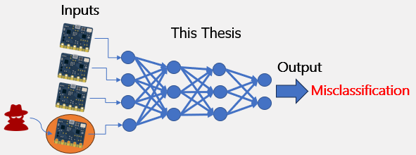
Structure of Thesis
Ta
Experiments on AEs for DNN Models Using Multimodal Sensors
(Chapter 3)
Network Forensics Analysis of Ransomware
(Chapter 2)
Detection of Sensors Used for AEs Against DNN Models
(Chapter 4)
Traditional Cyberattack
Complex System Cyberattack

Slide 12
Analysis of Cerber Ransomware Behavior Based on Network Forensics
02
Chapter
Kurniawan, A., & Riadi, I. (2018). Detection and Analysis Cerber Ransomware Using Network Forensics Behavior Based. International Journal of Network Security, 20(5), 1–8. https://doi.org/10.6633/IJNS.201809_20(5).04.
Notes:
Reduce side

Slide 13

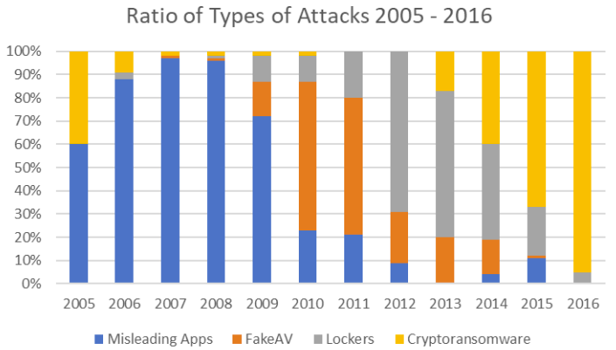
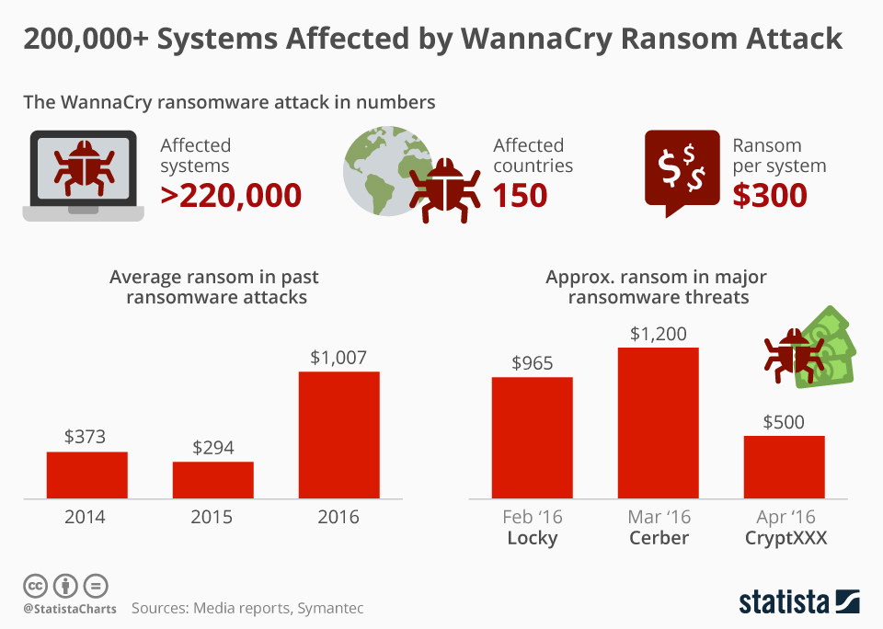
Case study: 2016 Los Angeles hospital ransomware attack
2016: A Year of Ransomware Attacks
Top three of Ransomware; Cerber, Locky, and CryptXXX
[1]
J. E. Thomas, “Using digital forensic techniques to investigate and detect ransomware infection,” no. June, pp. 1–18, 2018, doi: 10.13140/RG.2.2.18008.39683
https://www.statista.com/chart/9399/wannacry-cyber-attack-in-numbers/

Slide 14


Ransomware
This thesis proposes a method for reconstructing an event chain from packet-capture data to identify infected hosts and infection routes using the Network Forensics Approach.
Previous studies have focused on the detection of ransomware.
Static detection methods.
Traditional antivirus
Dynamic detection methods.
Eexecuting malware in a VM.

Slide 15

Cerber Ransomware – A Case Study
Cerber Ransomware – A Case Study
RaaS model.
AES encryption
Geolocation-based victim targeting.
System infiltration and persistence techniques
Stealthy operations in Safe Mode
Psychological impact on victims through fake alerts and notes
The threat to organizations and individuals
Notes:
Research investigators currently believe that Cerber originated in Russia because the ransomware will not infect users in Russia or neighboring countries such as Uzbekistan, Moldova, Armenia, and Kyrgyzstan

Slide 16
OSCAR Methodology: A Comprehensive Framework for Network Forensics Investigations[1]
Obtain Information
Strategize
Collect Evidence
Analyze
Report
1. Gather incident information and context.
2. Prioritize and plan evidence collection.
3. Collect evidence methodically, ensuring legal integrity.
4. Analyze the evidence to understand the incident.
5. Report findings in a non-technical, clear format.
1/21/2024
16
[1] J. Ham and S. Davidoff, “Network Forensics: Tracking Hackers through Cyberspace,” 2012.

Slide 17
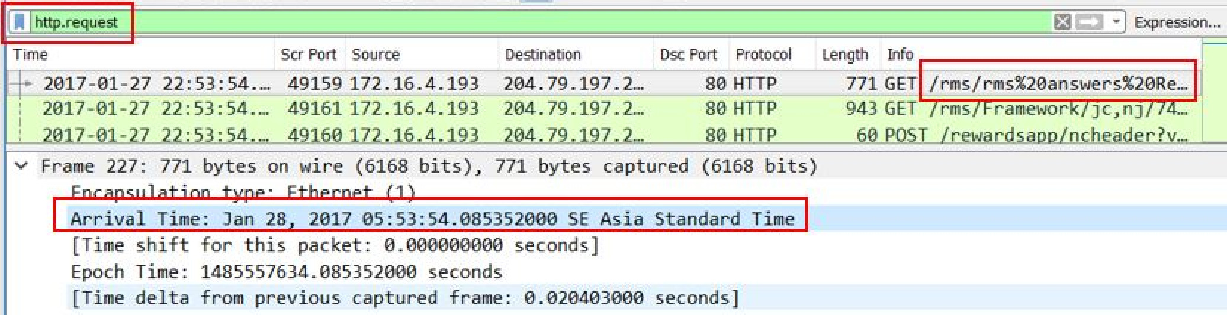
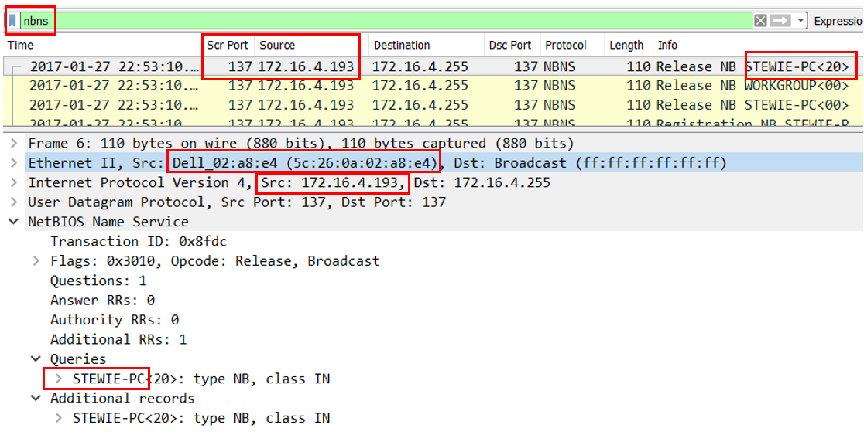
The Chain of Events of a Ransomware Attack.
Using Wireshark Network with an HTTP.request filter, we determined the host computer's initial infection time as January 27, 2017, at 22:53:54 UTC.
Initial infection time and hostname of first infected PC
Using a NetBIOS Name Service filter, we identified the infected computer's IP address as 172.16.4.193, MAC Address as 5c:26:0A:02:a8:e4 and hostname as Stewie PC.

Slide 18
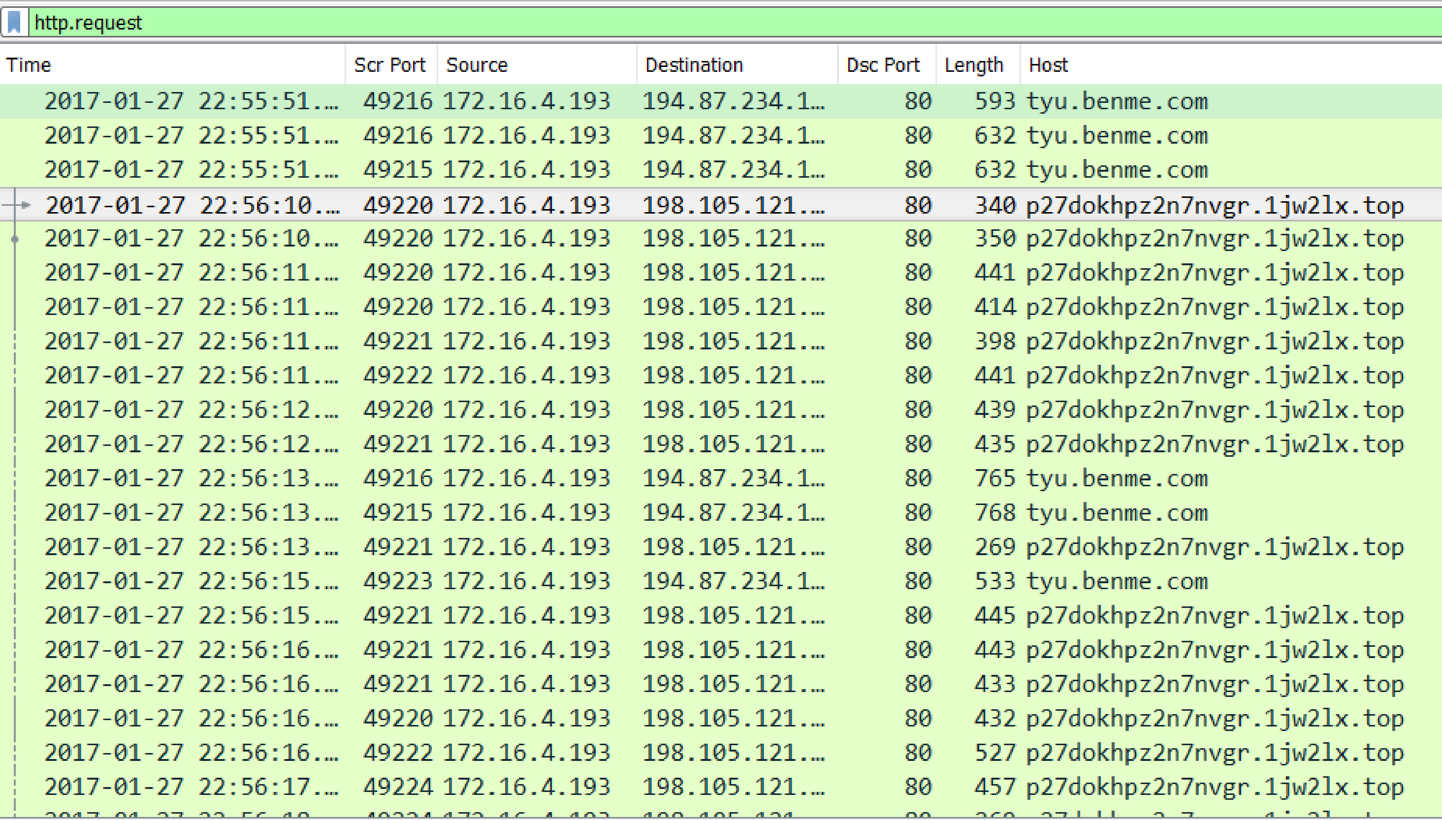
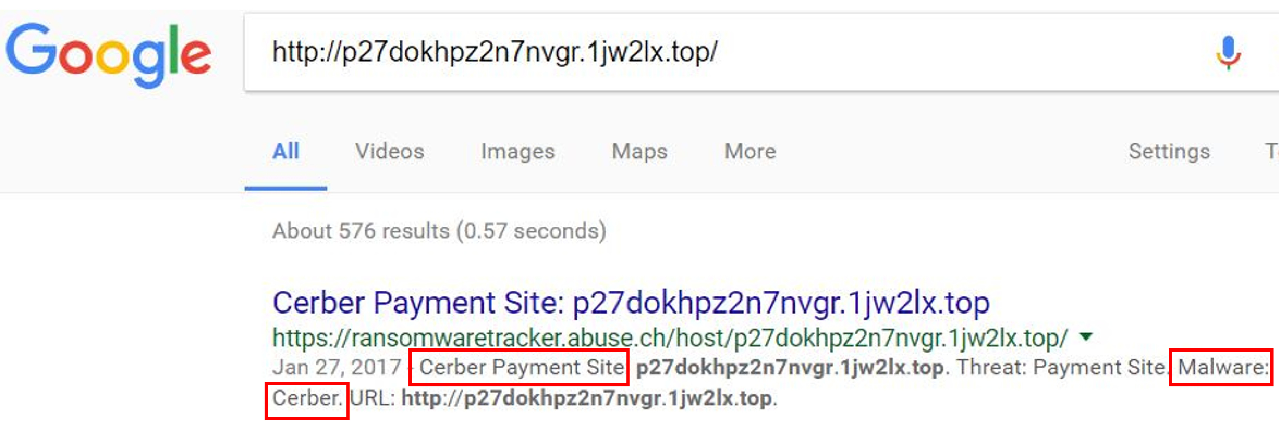
The Chain of Events of a Ransomware Attack.
We identified the malware on Stewie PC by analyzing traffic to domain.top and other malicious .onion links.
Focus on identifying malware.
We discovered that the domain p27dokhpz2n7nvgr.1jw2lx.top, linked to the CERBER Ransomware infecting Stewie PC, as shown in Google search results.

Slide 19
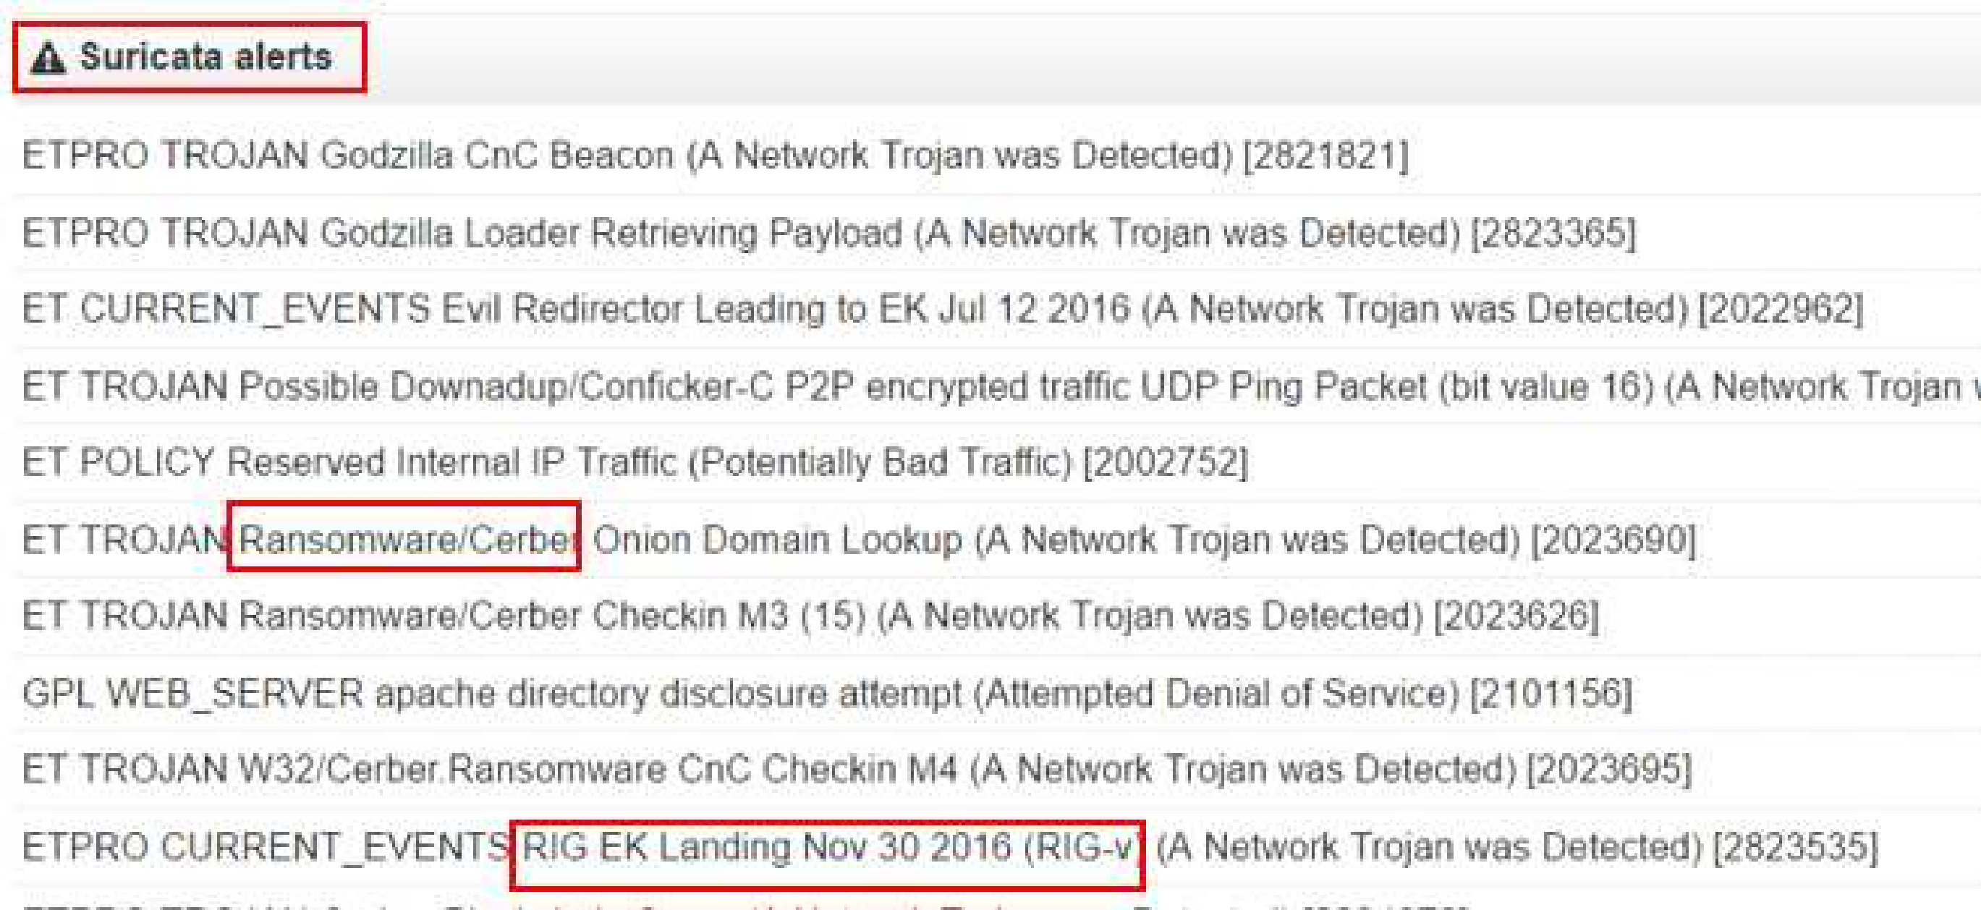
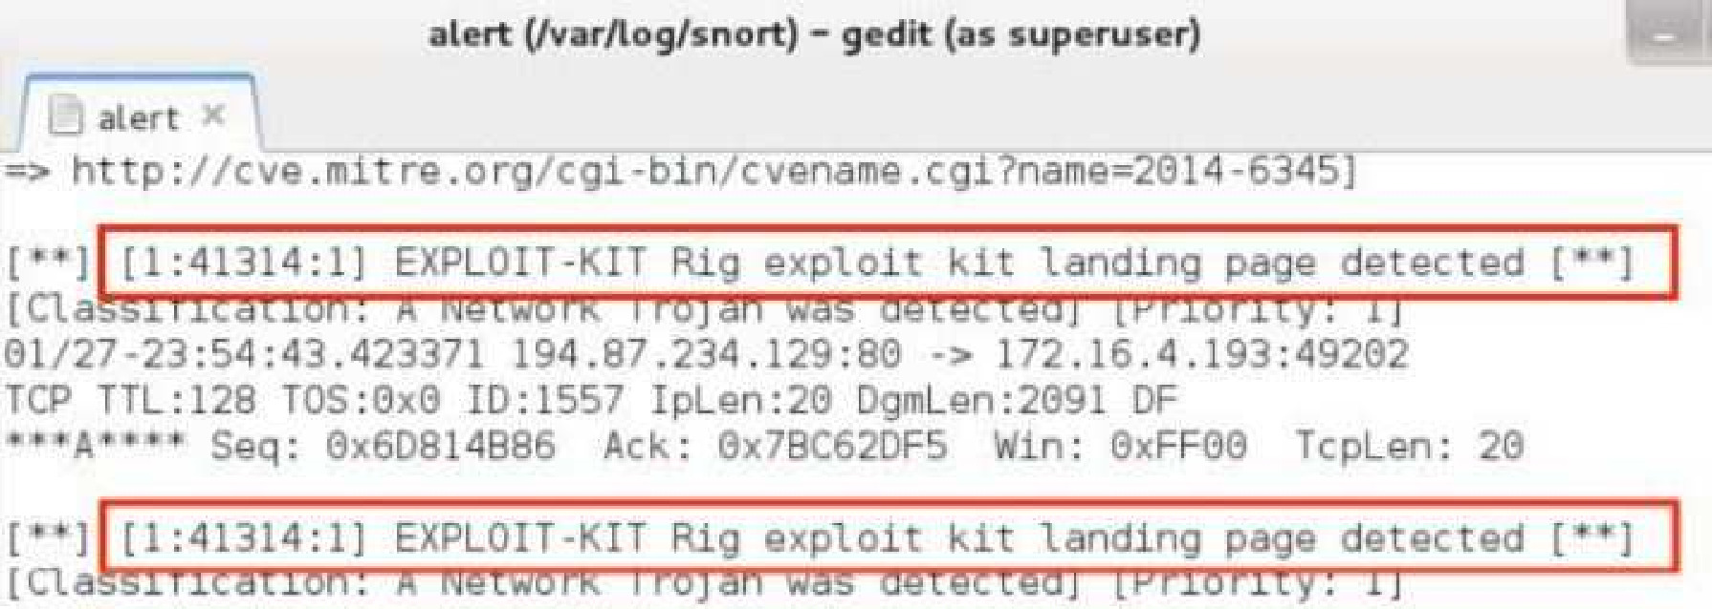
The Chain of Events of a Ransomware Attack.
PCAP analysis reveals RIG Exploit Kit used to distribute Cerber ransomware, confirmed by Suricata alert. This advanced toolkit exploits vulnerabilities to spread malware.
Snort analysis shows RIG EK landing page, confirming exploit kit activity. RIG EK often delivers malware payloads through browser vulnerabilities, putting users at risk.

Slide 20
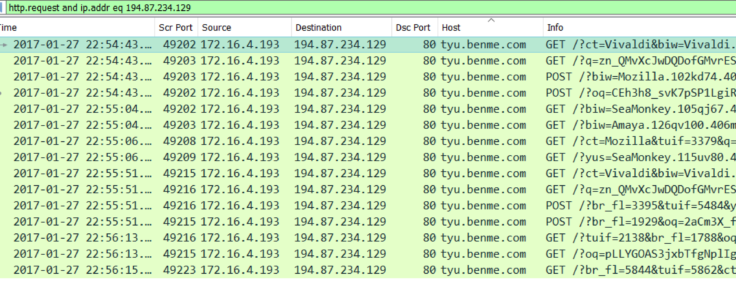
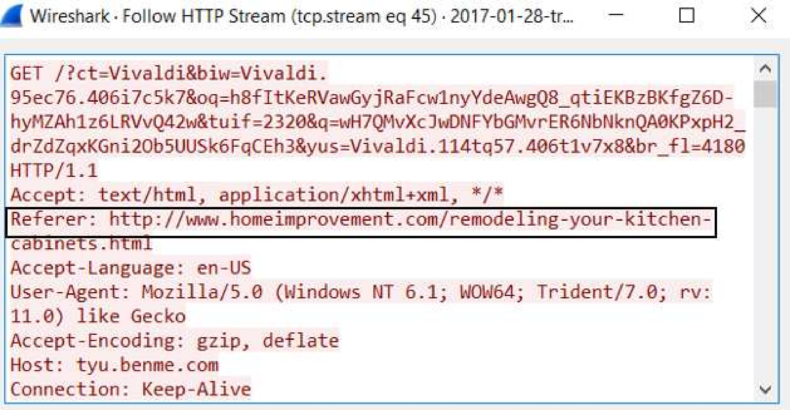
The Chain of Events of a Ransomware Attack.
Filtering Results Analysis: Filtering revealed IP address 194.87.234.129 associated with Rig EK, indicating exploit kit activity.
Wireshark Filtering: We detect and analyze the RIG EK and the domain website facilitating the infection spread.
Analysis Findings: Showed that the host computer accessed `www.homeimprovement.com`.
Role Victim's Activity: The victim visited this site while searching for "remodeling your kitchen cabinets" on `https://www.bing.com/`.

Slide 21
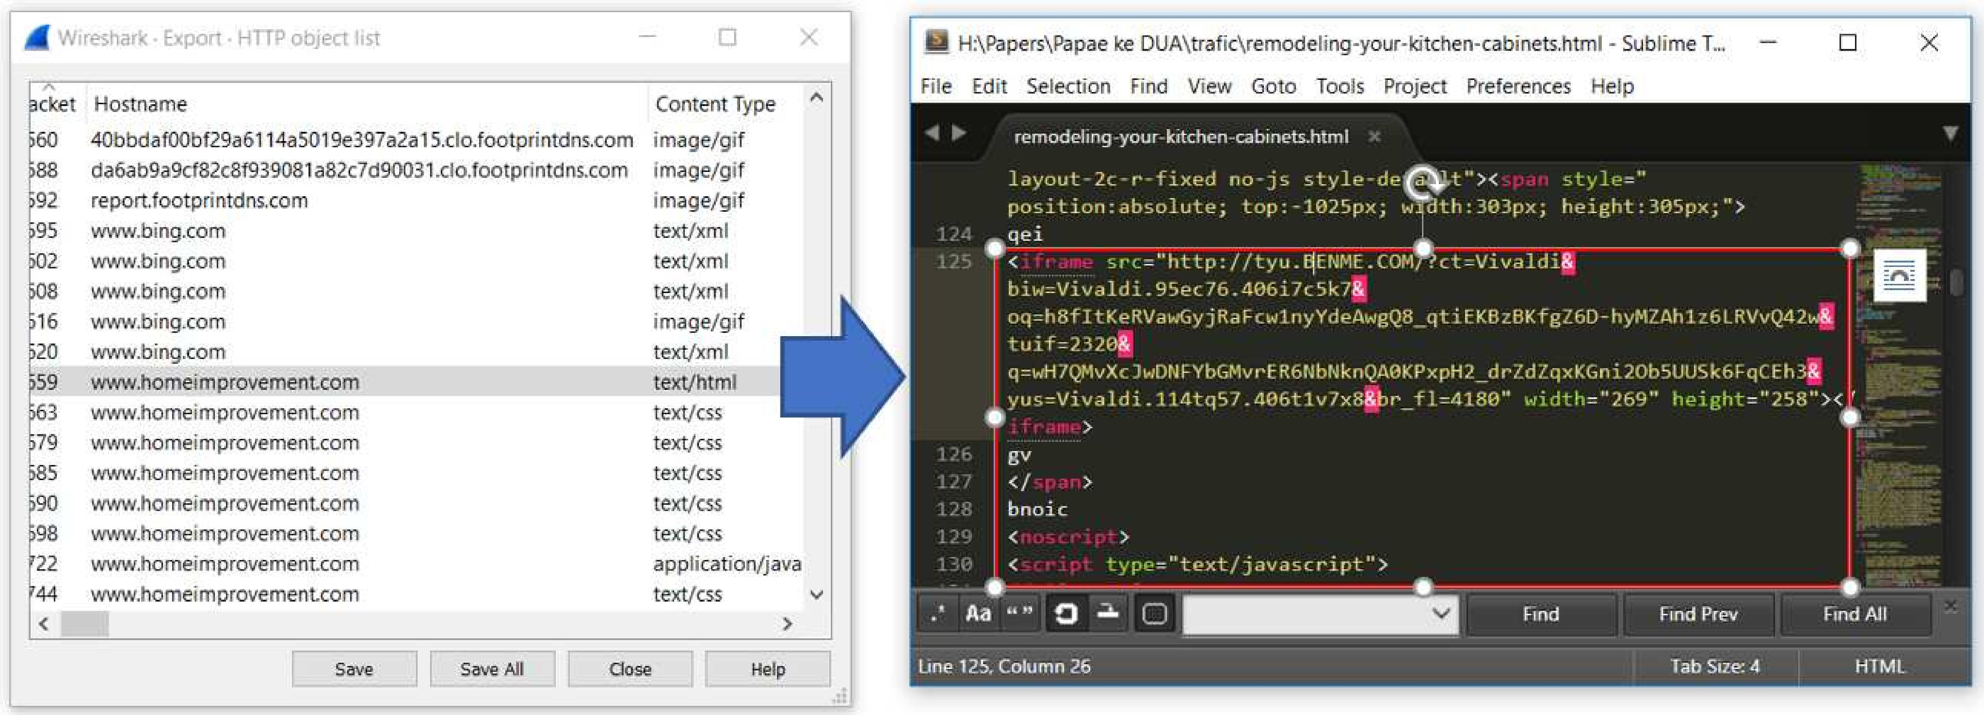
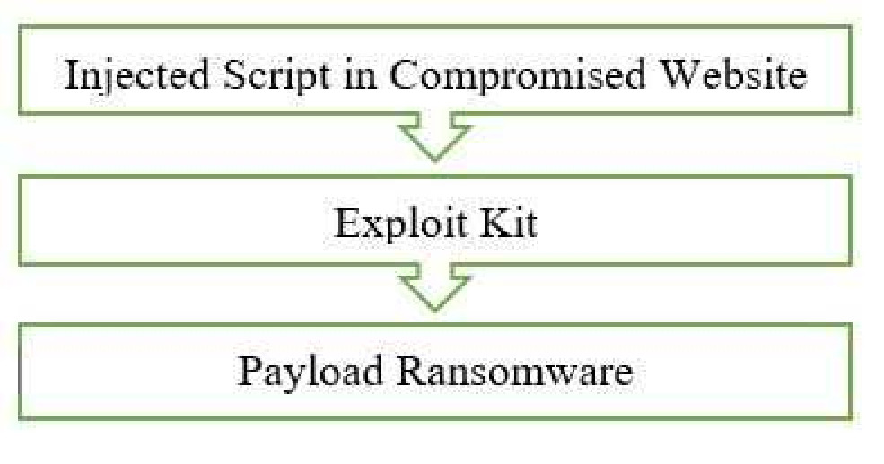
The Chain of Events of a Ransomware Attack.
Analysis showed `www.homeimprovement.com` was compromised to distribute RIG EK using a multi-stage, sophisticated method, where Cerber script stealthily redirects traffic to the Exploit Kit server.
Chain of Events in PseudoDarkleech Campaign:
- The victim visits a compromised website.
- The website makes an HTTP request to the Exploit Kit Landing Page.
- The EK evaluates the computer for vulnerabilities, especially in browser-based applications and Adobe Flash Player.
- If vulnerabilities are found, the EK delivers the ransomware payload for encryption and to restrict file access.

Slide 22
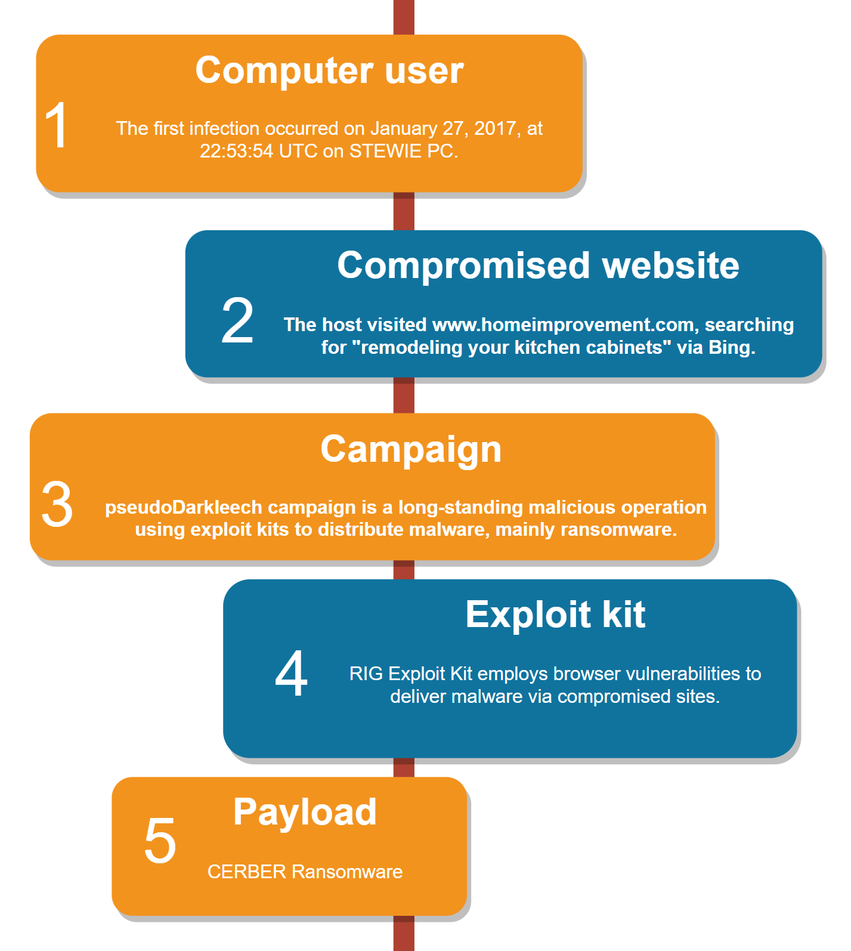
Chapter 2 Summary
  Attack chain: innocent search leads to a compromised site, redirects victim to exploit kit server, downloads Cerber Ransomware.
  Vulnerability: highlights need for system updates and vulnerability patching.
  Acknowledges that network forensics may not be sufficient against adversarial examples in sensor and machine-learning integrations.
  Suggests a focus on developing strategies against adversarial attacks in sensor ML integrated systems, aiming for enhanced sensor robustness and ML model resilience.

Slide 23
Experiments on Adversarial Examples for Deep Learning Model Using Multimodal Sensors
03
Chapter
A. Kurniawan, Y. Ohsita, and M. Murata, “Experiments on Adversarial Examples for Deep Learning Model Using Multimodal Sensors,” Sensors, vol. 22, no. 22, p. 8642, Nov. 2022, doi: 10.3390/s22228642
 | State-of-the-art DNNs are vulnerable to adversarial examples
 | Adversarial examples are inputs designed by an adversary that cause a machine learning system to generate incorrect outputs
 | Some studies have demonstrated that an attacker can fool machine learning models for HAR
Notes:
Jelsakn ebih jauh

Slide 24

AI based on DNNs has significantly impacted human lives
AI is widely used in many areas, such as smart nations, agriculture, medicine, industry, and HAR.
Many IoT sensor devices are used to achieve accurate recognition of the real world.
Notes:
AI based on DNNs has significantly impacted human lives
AI is widely used in many areas, such as smart nations, agriculture, medicine, industry, and HAR.
Many IoT sensor devices are used to achieve accurate recognition of the real world.

Slide 25

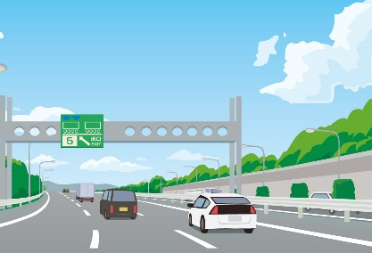

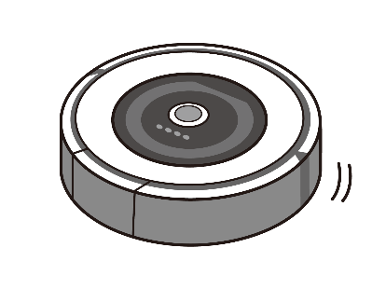
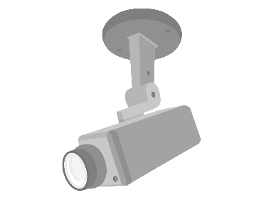

Impact of Machine Learning Attacks
Disruption of rival companies
Demanding money from AI as a hostage
terrorism
security
Smart Factories
Medical
Autonomous driving
Appliances in the home
Decline in the value of goods
Disable security
↓
Physical intrusion
Makes it possible
Shutting down the factory
Wrong diagnosis.
Occurrence of serious accidents

Slide 26
Inputs
Current Situation
Related works
Hacking a small number of sensors creates a significant risk.
An attacker may hack a small part of the sensor.
Some papers demonstrated that adversarial examples on the DNN model based on IoT sensors are possible [2], but with the assumption that an attacker can access all features of the model [3 - 8].
Output
Misclassification
Inputs
Output
This Thesis
Misclassification
[2] J. Classen, D. Wegemer, P. Patras, T. Spink, and M. Hollick, “Anatomy of a Vulnerable Fitness Tracking System,” Proc. ACM Interactive, Mobile, Wearable Ubiquitous Technol., vol. 2, no. 1, pp. 1–24, Mar. 2018, doi: 10.1145/3191737
[3] I. J. Goodfellow, J. Shlens, and C. Szegedy, “Explaining and harnessing adversarial examples,” 3rd Int. Conf. Learn. Represent. ICLR 2015 - Conf. Track Proc., pp. 1–11, 2015.
[4] A. Kurakin, I. Goodfellow, and S. Bengio, “Adversarial Machine Learning at Scale,” 5th Int. Conf. Learn. Represent. ICLR 2017 - Conf. Track Proc., pp. 1–17, Nov. 2016, [Online]. Available: http://arxiv.org/abs/1611.01236
[5] N. Carlini and D. Wagner, “Towards Evaluating the Robustness of Neural Networks,” in 2017 IEEE Symposium on Security and Privacy (SP), May 2017, pp. 39–57. doi: 10.1109/SP.2017.49.
[6] R. Kumar Sah and H. Ghasemzadeh, “Adversarial Transferability in Wearable Sensor Systems,” arXiv, vol. 1, no. 1, pp. 1–23, 2020.
[7] S. Jandial, P. Mangla, S. Varshney, and V. Balasubramanian, “AdvGAN++: Harnessing latent layers for adversary generation,” Proc. - 2019 Int. Conf. Comput. Vis. Work. ICCVW 2019, pp. 2045–2048, 2019, doi: 10.1109/ICCVW.2019.00257.
[8] A. Liu et al., “Perceptual-sensitive GAN for generating adversarial patches,” 33rd AAAI Conf. Artif. Intell. AAAI 2019, 31st Innov. Appl. Artif. Intell. Conf. IAAI 2019 9th AAAI Symp. Educ. Adv. Artif. Intell. EAAI 2019, pp. 1028–1035, 2019, doi: 10.1609/aaai.v33i01.33011028.
Notes:
Though not previously addressed, this thesis explores the impact of hacking a small subset of sensors on machine learning models. We demonstrate that attackers can manipulate the output of ML models using values from only a portion of the sensors. This novel attack, termed "sensor-based AEs," poses a significant risk, as attackers may gain control over only a small number of sensors to achieve their malicious goals.

Slide 27


Generates Attack in a Small Number of Sensors.
Input data
Target Model
Output
$$X_{3}^{′}＝g（X_{3}）$$
Attack Targets
$$Y＝f（X）$$
Goals:
We discuss the possibility of attacks on DNN models by hacking a small number of sensors through experiments.
We demonstrate that an attacker can manipulate a DNN model, even in this case.
We introduce a generator that generates adversarial examples when a small number of sensor devices are hacked.
Generator
Assumptions:
The attacker can obtain the values of the hacked sensors and change them but cannot obtain and change the values of the other sensors.
We assume that the attacker first hacks the sensor device.

Slide 28

output
(Current Actions)
Standing still
Sitting
Lying down
Walking
Climbing stairs
Waist bends forward Frontal elevation of arms Knees bending
Cycling
Jogging
Running
Jump front & back
Attacker Capabilities
Eavesdropping and Tampering:
Attackers can listen in on and manipulate multiple sensors, exploiting their vulnerabilities.
Attacker's Knowledge:
The attacker may have stolen the target model through a Model Extraction attack or similar methods.
They might also estimate the values of non-eavesdropped sensors using the data from compromised ones, though with low accuracy.
This variable estimation accuracy can be used to gauge and test the attacker's level of prior knowledge.

Slide 29
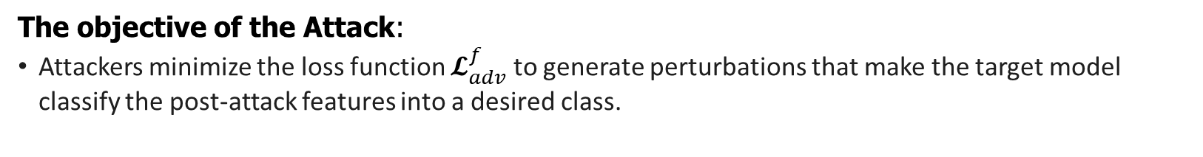
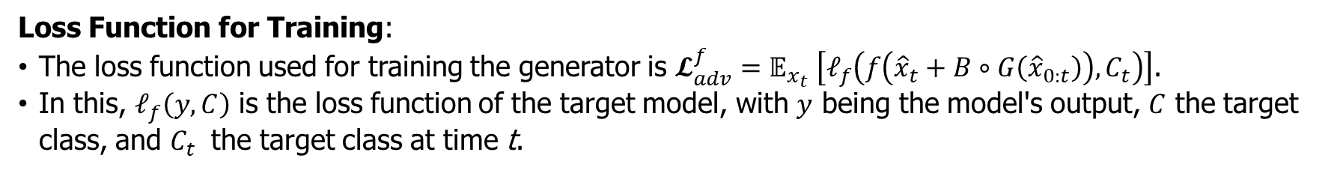
Attack Generator
Values for all sensors
Values for all sensors
Feature accumulation for time slots
Based on prior knowledge Estimator
Eavesdropping sensor values
Attack surface model
Attack Generator
perturbation
＋
Loss Function for Training:
The loss function used for training the generator is $𝓛_{adv}^{f}=𝔼_{x_{t}} \left[𝓁_{f}\left(f\left({\hat{x}}_{t}+B∘G\left({\hat{x}}_{0:t}\right)\right),C_{t}\right)\right]$​.
In this, $𝓁_{f}\left(y,C\right)$ is the loss function of the target model, with $y$ being the model's output, $C$ the target class, and $C_{t}$​ the target class at time t.
The objective of the Attack:
Attackers minimize the loss function $𝓛_{adv}^{f}$ to generate perturbations that make the target model classify the post-attack features into a desired class.

Slide 30




output
(Current Actions)
Standing still
Sitting
Lying down
Walking
Climbing stairs
Waist bends forward Frontal elevation of arms Knees bending
Cycling
Jogging
Running
Jump front & back
Validating the Attack
Input
Output
(Current Actions)
Standing still
Sitting
Lying down
Walking
Climbing stairs
Waist bends forward Frontal elevation of arms Knees bending
Cycling
Jogging
Running
Jump front & back
Machine learning model
Wrist, chest, and ankle sensors.
3-axis acceleration, 3-axis angular velocity, 3-axis magnetic, and heart rate
Attack surface (mHealth dataset: http://archive.ics.uci.edu/ml/datasets/mhealth+dataset)

Slide 31
Properties of the Target Model
Even with only the sensor of the part, it is possible to distinguish to some extent.
Improved accuracy by combining multiple sensors
Ground-truth Class | Precision |  |  |  |  |  | Recall
 | Target Model | Wrist |  | Ankle | Chest |  | Target Model | Wrist | Ankle | Chest
Standing | 100 | 96 | 96 |  |  | 41 | 100 | 100 | 88 |  | 48
Sitting | 100 | 99 | 98 |  |  | 54 | 100 | 96 | 97 |  | 54
Lying down | 100 | 96 | 99 |  |  | 100 | 100 | 98 | 99 |  | 100
Walking | 100 | 94 | 99 |  |  | 99 | 100 | 53 | 99 |  | 98
Climbing stairs | 99 | 79 | 98 |  |  | 98 | 100 | 97 | 99 |  | 100
Waist bends forward | 100 | 83 | 96 |  |  | 100 | 100 | 94 | 99 |  | 94
Frontal elevation of arms | 98 | 100 | 89 |  |  | 87 | 100 | 99 | 97 |  | 75
Knees bending | 100 | 76 | 99 |  |  | 100 | 96 | 80 | 97 |  | 66
Cycling | 96 | 98 | 98 |  |  | 76 | 100 | 100 | 98 |  | 98
Jogging | 98 | 99 | 98 |  |  | 87 | 93 | 100 | 93 |  | 94
Running | 94 | 97 | 93 |  |  | 92 | 97 | 99 | 98 |  | 89
Jump front & back | 95 | 97 | 92 |  |  | 100 | 97 | 89 | 94 |  | 94

Slide 32

output
(Current Actions)
Standing still
Sitting
Lying down
Walking
Climbing stairs
Waist bends forward Frontal elevation of arms Knees bending
Cycling
Jogging
Running
Jump front & back
Prior Knowledge of the Attacker
At the time of verification, the estimator is trained based on the training data as equivalent to the attacker's prior knowledge
Varies the data used to train the estimator to generate cases where the attacker's prior knowledge is close to the target of the attack and when it is different from the target of the attack.
Learning Method: Learning with GAN
Eavesdropping sensor values
Otherwise
Sensor Values
True or False
Presumption(RNN)
Discriminator
(LSTM)

Slide 33
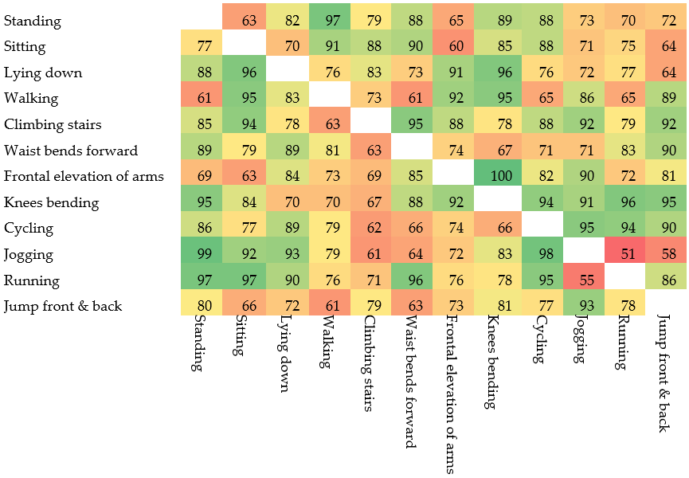
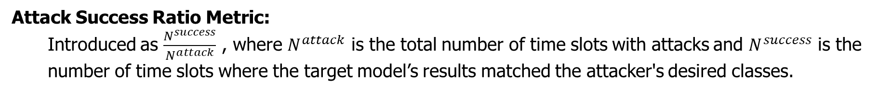
Demonstration of the Attack
Case of Full Sensor Knowledge:
Attack Success Ratio Metric:
  Introduced as $\frac{N^{success}}{N^{attack}}$ ​, where $N^{attack}$ is the total number of time slots with attacks and $N^{success}$ is the number of time slots where the target model’s results matched the attacker's desired classes.
  Success ratio depends on the classes; some attacks (e.g., frontal elevation of arms to knee bending) had high success, while others (e.g., jogging to running) had low success rates.
  Attacks succeeded more than half of the time by altering ankle sensor values, even though other sensors also significantly impact classification.

Slide 34
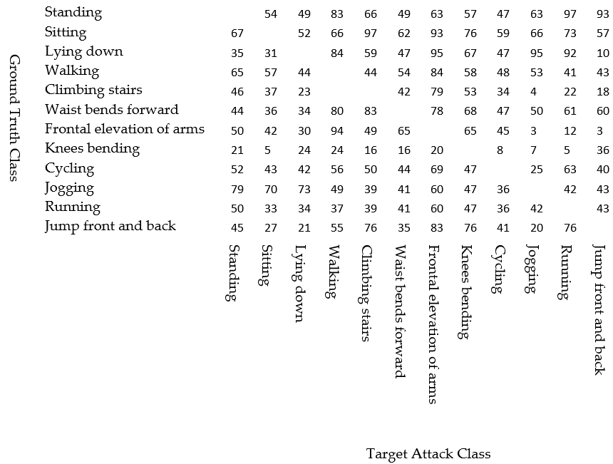
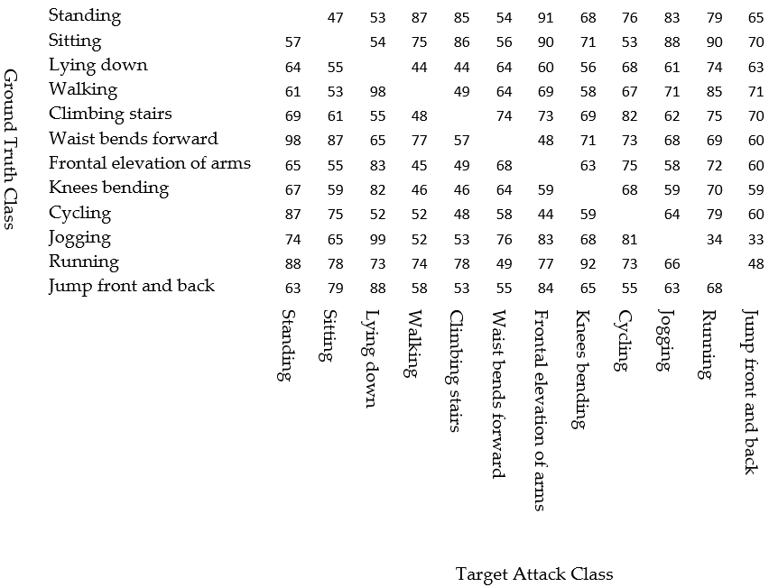
Demonstration of the Attack (2)
Impact of Attacker's Knowledge:
  The success ratio of attacks decreased as the number of subjects used for training the estimator decreased.
  Some attacks succeeded even without accurate information on other sensors. For instance, attacks from frontal elevation of arms to walking were successful, while those to jogging or jumping front and back largely failed.
Case with estimator trained by five subjects
Case with estimator trained by three subjects

Slide 35
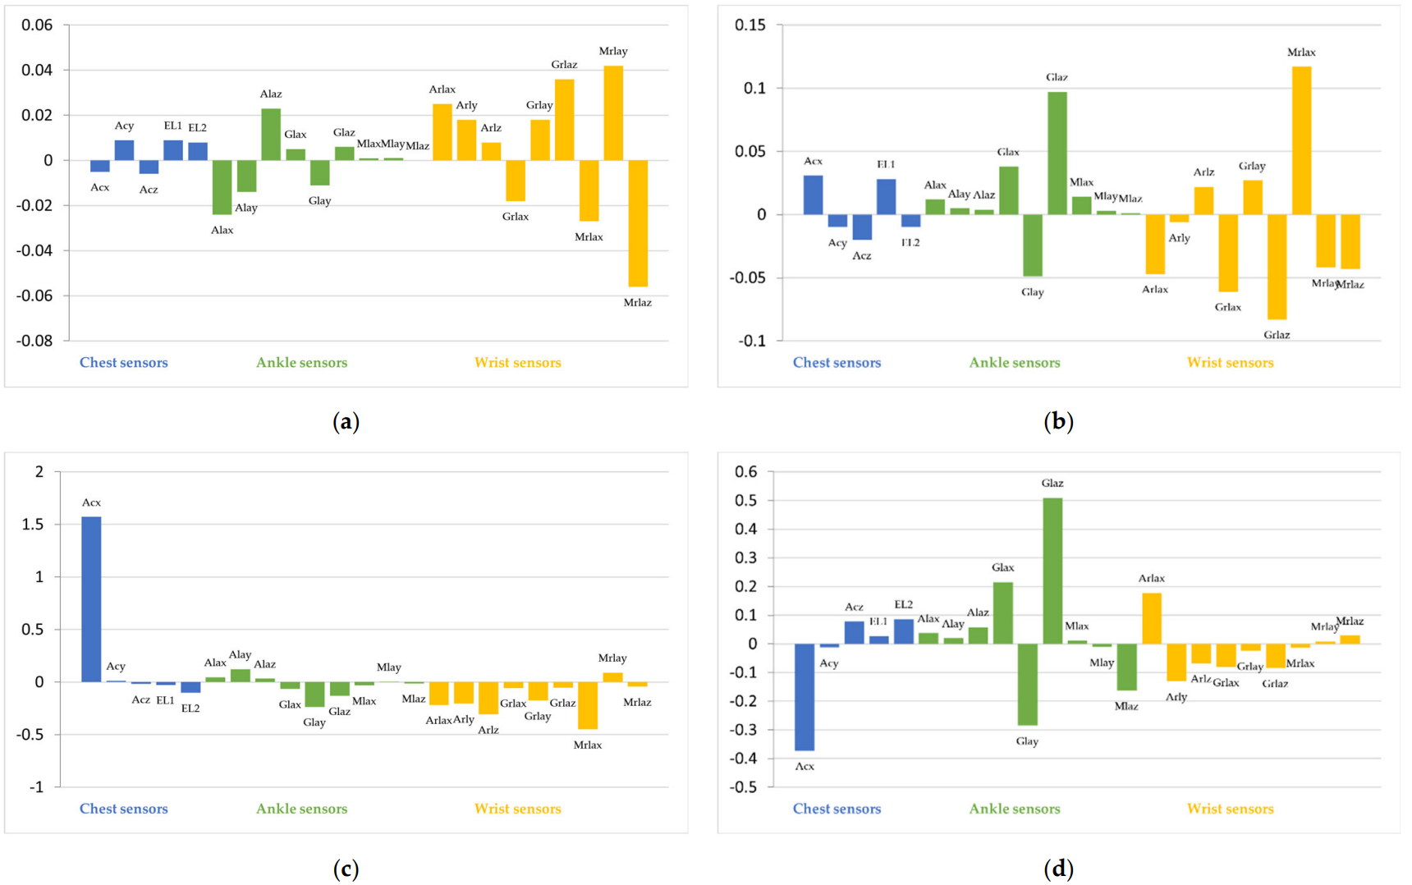
Property of the Generated Attacks
Attack Success with Inaccurate Knowledge:
Attacks, Frontal-to-walking, succeeded despite limited attacker knowledge due to the strong influence of hacked sensor features (e.g., ankle) on classification.
Figure (d) demonstrates successful attacks with limited knowledge. Features from the ankle sensor dominate classification, even without full information from other sensors
(a) Frontal to Walking (full knowledge) (b) Frontal to Jogging (full knowledge) (c) Frontal to Jump (full knowledge) (d) Frontal to Walking (3-subject estimator)
Notes:
Jeaskan ebih jauh

Slide 36
Chapter 3 Summary
Overview of Chapter
Demonstration of Attack
Attack Scenario: Discussed the feasibility of attacking DNN models by hacking a limited number of sensors.
Attacker's Capabilities: The attacker can hack a sensor to obtain and modify their values but cannot access or alter the values of other sensors.
Attack Demonstration: Utilize an open dataset for HAR, which involves sensors placed on the chest, wrist, and ankle.
Attack Effectiveness: The attacker can change the output of the target model by hacking only one of the three sensor devices.
Study Contributions
Focus of Next Chapter
Adversarial Example Generator: Introduced a generator that creates adversarial examples in a sensor device is compromised. This generator uses data from the hacked sensors to generate perturbations.
Perturbations and Classification: The perturbations are designed so that the altered features are classified into the attacker's desired target class by the target model.
Future Discussion: The next chapter will delve into the properties of these attacks, including potential countermeasures to safeguard against them.

Slide 37
Chapter
04
Detection of Sensors Used for Adversarial Examples Against Machine Learning Models
Kurniawan, Y. Ohsita, S. Maisuria, and M. Murata, “Detection of sensors used for adversarial examples against machine learning models,”. Computers and Electrical Engineering, 2023, doi: 10.20944/preprints202311.0328.v1. (Under-review)
Ade Kurniawan, Yuichi Ohsita, and Masayuki Murata, ``Toward Robust Systems against Sensor-Based Adversarial Examples Based on the Criticalities of Sensors,'' to be presented at IEEE 3rd International Conference on AI in Cybersecurity (ICAIC), Houston, Texas, February 7–9, 2024.
1/21/2024
37
Notes:
Tambahkan agoritma beserta penjeasannya

Slide 38

output
(Current Actions)
Standing still
Sitting
Lying down
Walking
Climbing stairs
Waist bends forward Frontal elevation of arms Knees bending
Cycling
Jogging
Running
Jump front & back
Adversarial Training (AT): One method to counter AEs.
  However, not protect against new types of attacks.
Detection of AEs: Various methods fail to identify the specific sensors manipulated by attackers.
Proposed Method: This thesis introduces the feature-removable model (FRM) a method for detecting attacks and identifying the sensors used by attackers.
Methodology: Detects attacks based on inconsistencies between classifications.

Slide 39
Attack Prevention
Input data
Isolate the sensors that have been hijacked by the attacker.
          Preventing the Impact of Attacks.
This model can also be used to identify anomalous sensors
          When all sensors are used
machine learning
model
Output data
Specify the sensor to be used

Slide 40
Attack Prevention
This model can also be used to identify anomalous sensors
          Exclude suspicious sensors.
This model can also be used to identify anomalous sensors
          When all sensors are used
Input data
machine learning
model
Output data
Specify the sensor to be used

Slide 41
Attack Prevention
This model can also be used to identify anomalous sensors
Exclude suspicious sensors.
machine learning
model
Not walking
Necessary.. perhaps
If this sensor were not used, the results would be different.
Specify the sensor to be used
Compromised sensors！！

Slide 42
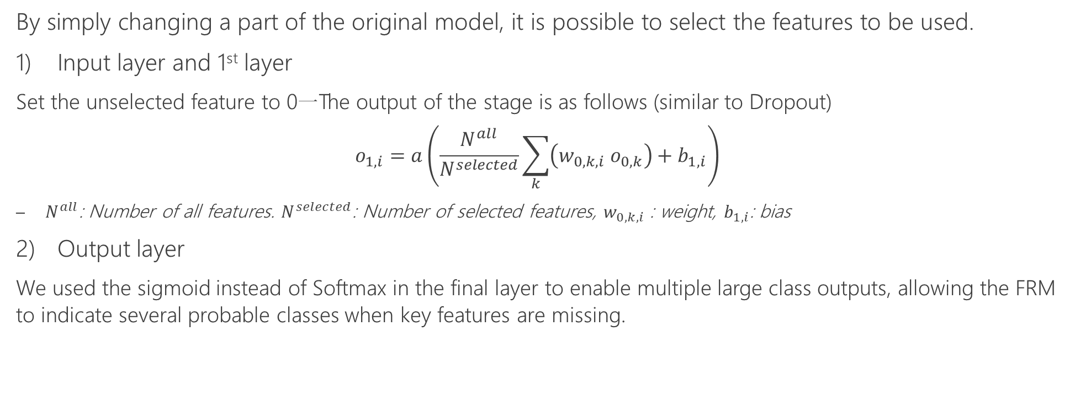
Framework Against Sensor-Based Adversarial Examples
1st layer
original model
Final layer
feature-removable model (FRM)
By simply changing a part of the original model, it is possible to select the features to be used.
Input layer and 1st layer
  Set the unselected feature to 0一The output of the stage is as follows (similar to Dropout)
  $$o_{1,i}=a\left(\frac{N^{all}}{N^{selected}}\sum_{k}{\left(w_{0,k,i} o_{0,k}\right)+b_{1,i}}\right)$$
    $N^{all}$: Number of all features. $N^{selected}$: Number of selected features, $w_{0,k,i}$ : weight, $b_{1,i}$: bias
Output layer
  We used the sigmoid instead of Softmax in the final layer to enable multiple large class outputs, allowing the FRM to indicate several probable classes when key features are missing.
1/21/2024
42

Slide 43
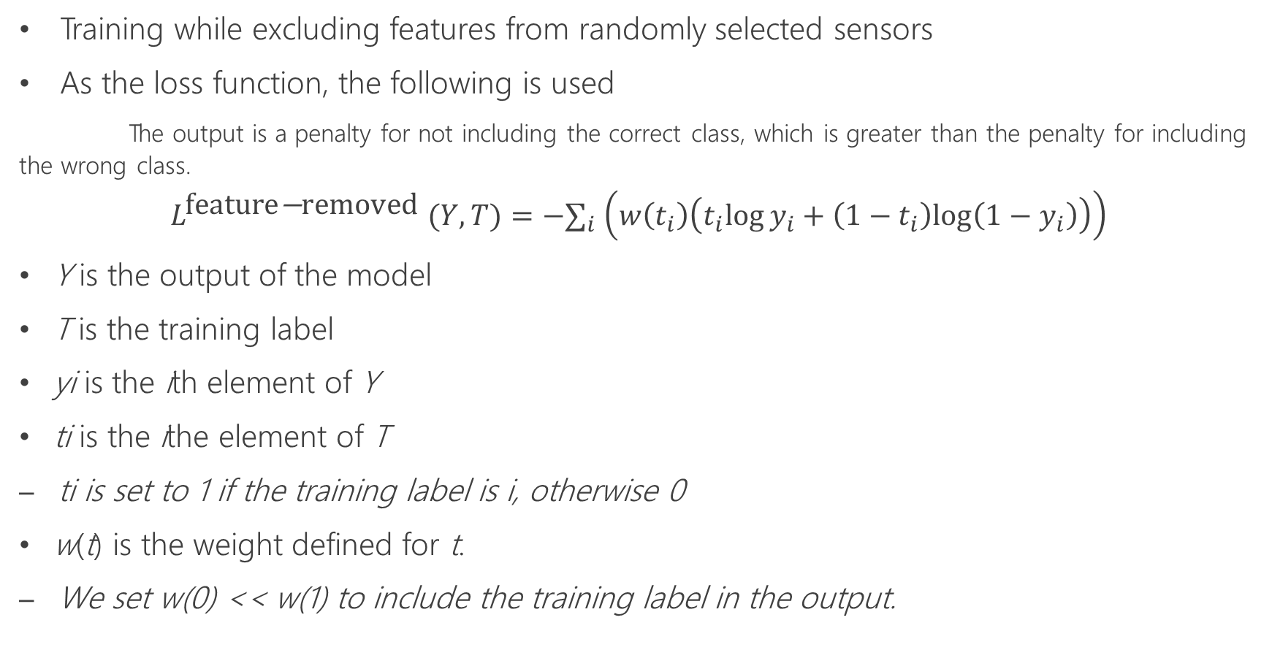
Training Feature Removable Model
Training while excluding features from randomly selected sensors
As the loss function, the following is used
      The output is a penalty for not including the correct class, which is greater than the penalty for including the wrong class.
$$L^{\text{feature}\text{−}\text{removed} }(Y,T)=−∑_{i} \left(w\left(t_{i}\right)\left(t_{i}log⁡y_{i}+\left(1−t_{i}\right)log⁡\left(1−y_{i}\right)\right)\right)$$
  Y is the output of the model
  T is the training label
  yi is the ith element of Y
  ti is the ithe element of T
    ti is set to 1 if the training label is i, otherwise 0
  w(t) is the weight defined for t.
    We set w(0) << w(1) to include the training label in the output.

Slide 44
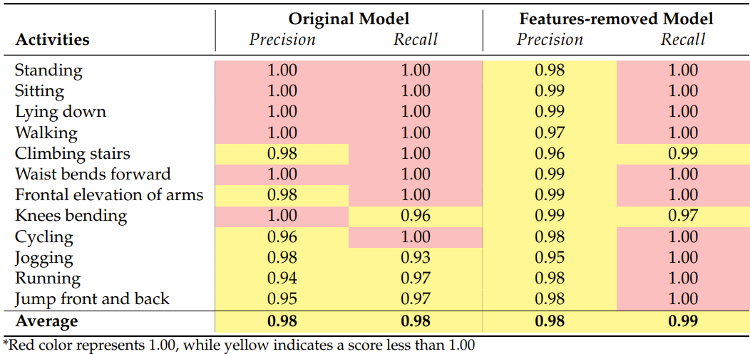
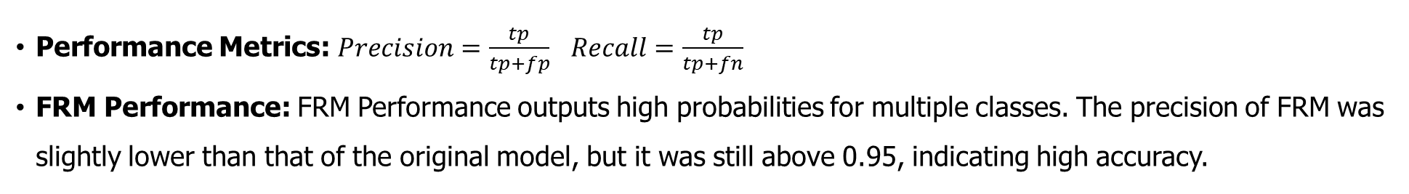
Property of the Feature Removable Model (FRM) Without Attack
Performance Metrics: $Precision=\frac{tp}{tp+fp}$ $Recall=\frac{tp}{tp+fn}$
  FRM Performance: FRM Performance outputs high probabilities for multiple classes. The precision of FRM was slightly lower than that of the original model, but it was still above 0.95, indicating high accuracy.
Notes:
The properties of the FRM were compared to the original model to understand its performance.
Performance Metrics: Precision and Recall are used as metrics, defined as: $Precision=\frac{tp}{tp+fp}$ $Recall=\frac{tp}{tp+fn}$
where tp (true positives) are correct identifications, and fp (false positives) are incorrect identifications of the target class. where fn (false negatives) are instances where the actual class is the target class, but it is not identified as such.
FRM Performance: The FRM can output high probabilities for multiple classes. Precision for FRM is slightly lower than the original model due to this allowance, but it is still above 0.95, indicating high accuracy

Slide 45
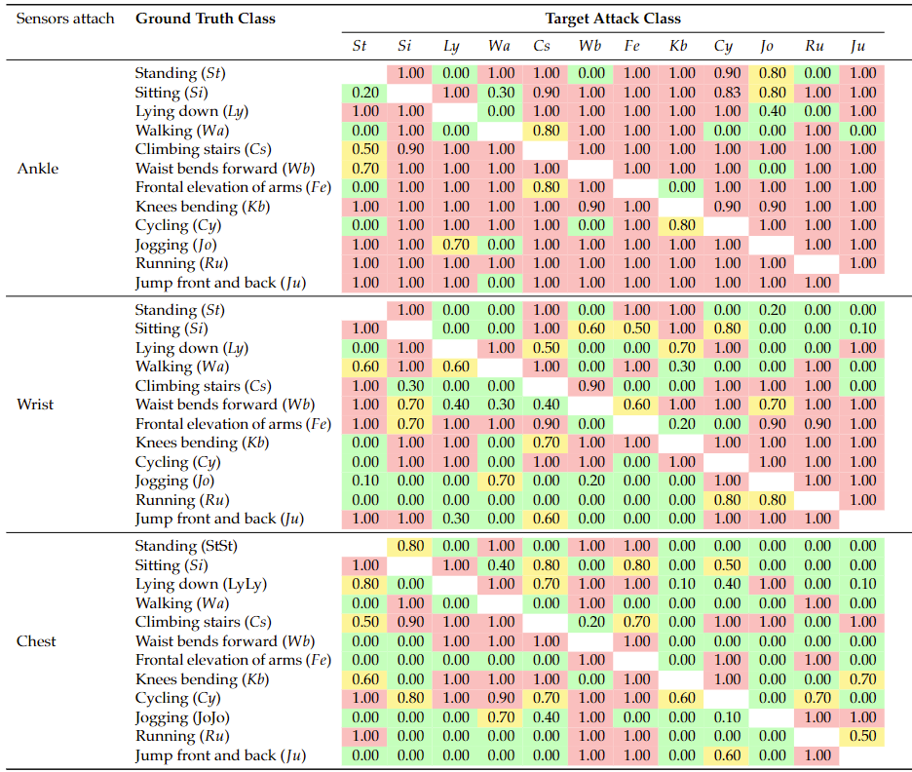
Property of the Attack on FRM
• Attack Success: Target class probability exceeding 0.60.
• Vulnerability: Ankle, wrist, and chest sensors are most vulnerable to diverse attacks.
• Attack Focus: This section focuses on successful attacks, which vary in success rate.

Slide 46
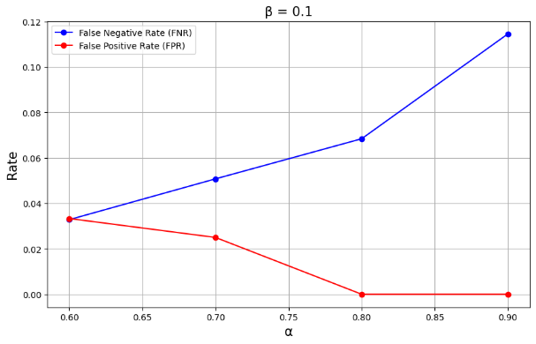
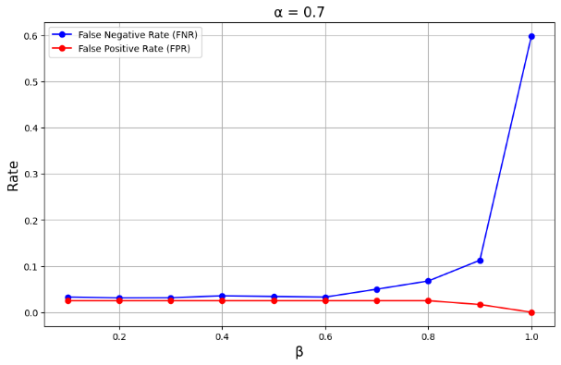
Accuracy of Attack Detection
Metrics:
  FNR (False Negative Rate): Percentage of undetected attacks.
  FPR (False Positive Rate): Percentage of clean data incorrectly flagged as attacks.
Formulae:
  FNR = FN / (FN + TP)
  FPR = FP / (FP + TN)
Parameter Impact:
  α and β parameters significantly affect detection.
  Higher values of α and β reduce FPR but increase FNR.
Trade-Off:
  Minimizing false alarms increases missed attacks.
Optimization:
  Achieved FNR < 0.03 and FPR < 0.06, demonstrating effective and balanced attack detection.
The results of impact when FNR and FPR were α value is changing and β = 0.1
result of impact when the β value is changing and α = 0.7

Slide 47
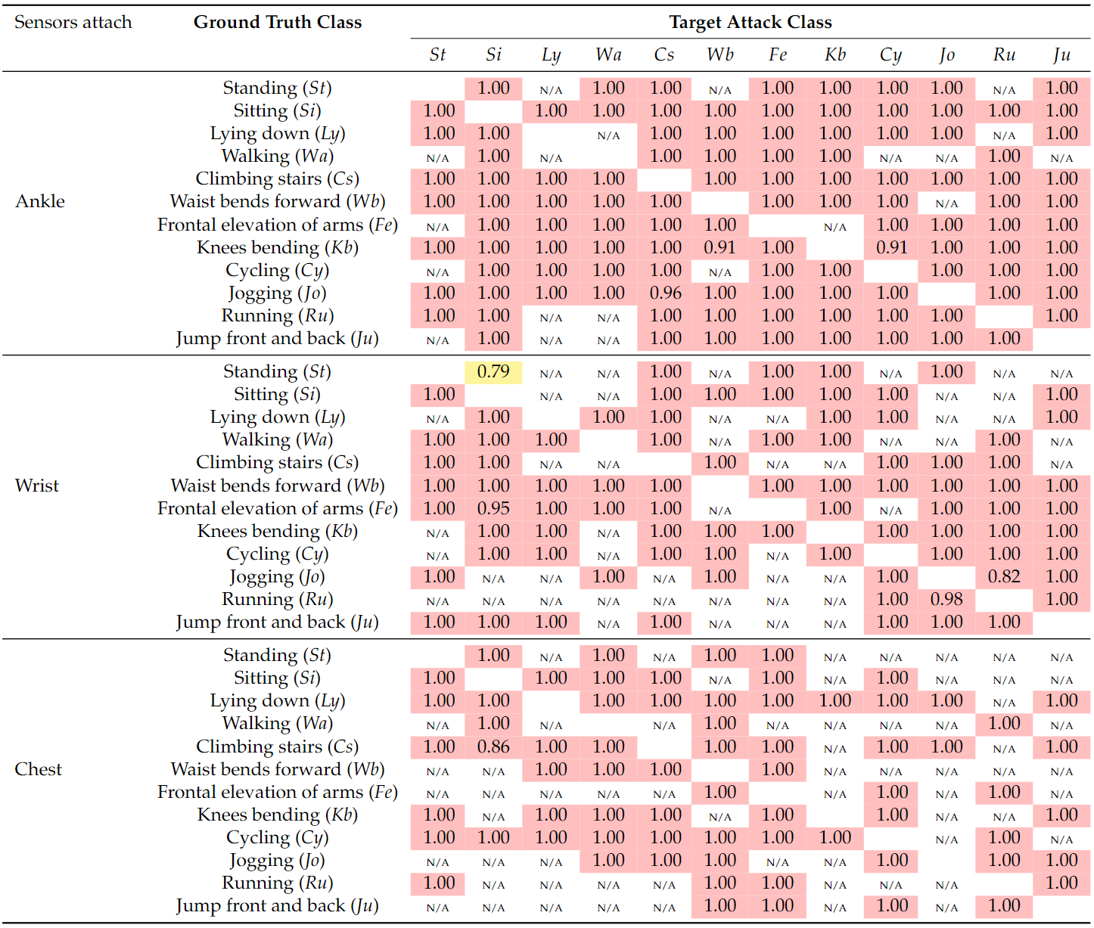
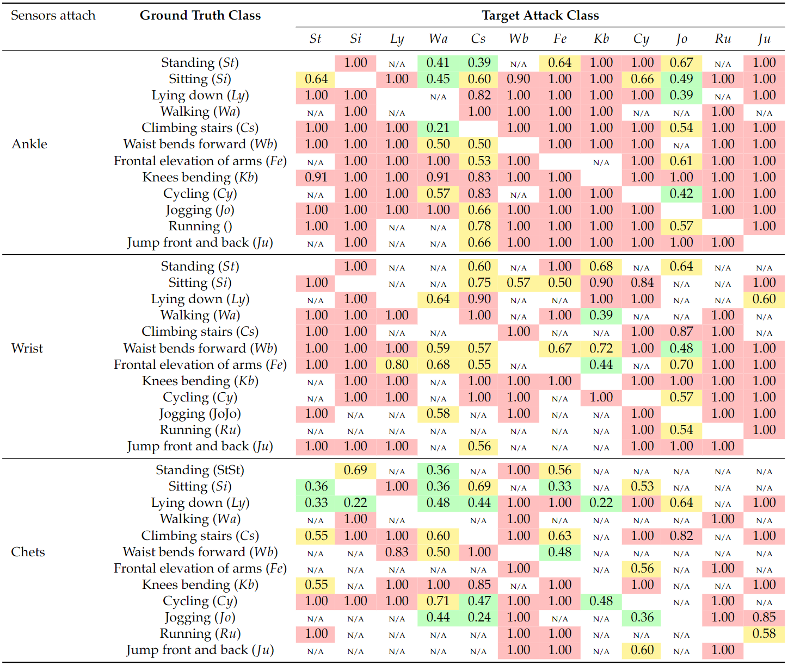
Accuracy of Detecting Compromised Sensors
Used by Attacker
Recall Of Detected Sensors
Precision Of Detected Sensors
The FRM achieved a high 'Recall Of Detected Sensors' (0.92 overall), indicating most sensors used in AEs are correctly detected
.
Notes:
Evaluation of Sensor Detection in AEs
Metrics:
Precision of Detected Sensors: Measures accuracy of identifying actual sensor involvement in AEs.
Formula: Precision = Truly Detected Sensors / (Truly Detected Sensors + Falsely Detected Sensors)
Recall of Detected Sensors: Measures completeness of identifying all sensors used in AEs.
Formula: Recall = Truly Detected Sensors / (Truly Detected Sensors + Missed Detected Sensors)
Performance Results:
High Recall Achievement: The method achieved a high 'Recall Of Detected Sensors' (0.92 overall), indicating most sensors used in AEs are correctly detected.
Effectiveness of the Method: The method effectively uses the features of the attack to detect changes in prediction results when attackers use compromised sensors.
Challenges in Detection:
Not Perfect Recall: In some cases, the 'Recall Of Detected Sensors' is not 100%. For example, it is 0.79 for AEs from standing to sitting class using the wrist sensor, due to difficulty distinguishing between the target class and actual class.
Solution Approach: Adding more sensors to the system could improve redundancy, making it easier to distinguish classes even if some sensors are excluded.

Slide 48
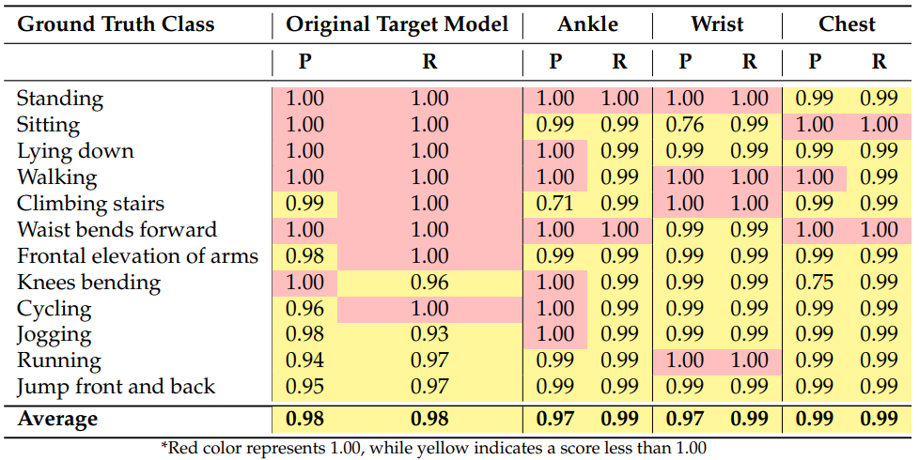
Mitigation of Sensor-based AEs by Excluding the Detected Sensors
Key Findings of Analysis:
The FRM accurately classifies without compromised data, proving its effectiveness.
Excluding data from key sensors, like the ankle during stair climbing, reduces precision, highlighting their importance.
Notes:
In most cases, the FRM, even without compromised sensor data, achieves accurate classification, showing its effectiveness.
For certain classes (e.g., climbing stairs), excluding specific sensor data (e.g., ankle sensor) can lead to lower precision, indicating the importance of those sensors for precise classification.
Despite lower precision in some cases, the FRM can still identify the actual class by suggesting multiple possibilities with high probabilities, compensating for the lack of specific sensor data

Slide 49
Criticality of Sensors
Defining Criticality
Reactive Defense and Sensor Limitations;
  Reactive sensor-based methods are less effective when key sensors for state distinction are compromised.
Redundancy's Role:
  Redundancy in systems helps maintain functionality despite compromised sensors, highlighting the need for a redundancy assessment metric.
Criticality Metric:
  Developed to evaluate the importance of sensor groups in classifying between two classes, focusing on the feasibility of distinction without certain sensors.
Calculating Sensor Group Criticality:
  This involves using FRM probabilities to measure a sensor group's importance in differentiating classes, where higher values imply greater difficulty in classification without that sensor group.

Slide 50
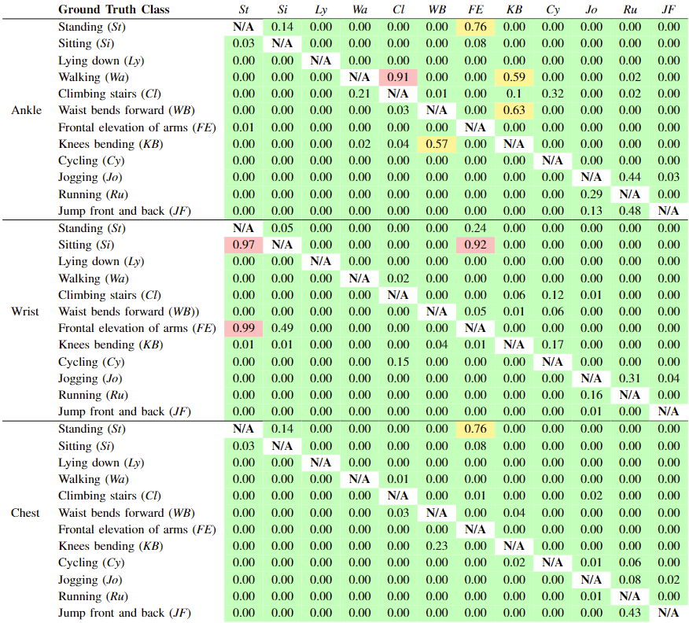
Criticality of Sensors
While most activities retained accurate classification with a single sensor missing, specific sensors like ankle (walking) and wrist (sitting) were crucial for certain activities.
This highlights vulnerabilities and the importance of redundancy for continued functionality despite compromised sensors.
Understanding criticality is crucial for defense, enabling effective strategies.
The criticality of each sensor device for each class pair

Slide 51
Chapter 4 Summary
Sensor Detection in Sensor-based AEs:
This research proposes a method for detecting sensors used in sensor-based AEs. It leverages features immune to attacker manipulation, enabling identification of compromised sensors.
Key points:
Feature-Removable Model (FRM): Selects sensor features for analysis and detects inconsistencies caused by manipulated sensors.
Post-Detection Application: Verifies and replaces compromised sensors.
FRM for Mitigation: Excludes features from detected sensors, reducing attack impact while potentially sacrificing some accuracy.
Future work:
Will focus on building robust multisensory systems for real-world use, demonstrating their resilience against sophisticated adversarial examples. This ensures continued system effectiveness against potential attacks.

Slide 52
Chapter
05
Conclusion
52
1/21/2024
52
1/21/2024

Slide 53
Conclusion
Overview of Thesis
Vulnerability of Machine Learning Models
Cyberattacks pose a major threat to critical infrastructures, jeopardizing system integrity, stability, and safety. Analyzing and understanding cyberattacks is vital for enhancing system resilience against evolving threats.
This research highlights the growing threat of cyberattacks on machine learning systems, particularly through adversarial examples. It emphasizes the need for improved protection strategies for critical infrastructures.
Impact of Compromised Sensors
Analysis of Ransomware Cyberattacks
Network Forensics: Analyzed ransomware attacks, identifying infection paths and event sequences.
CERBER Case Study: Investigated CERBER ransomware's spread through compromised sites and exploit kits.
This study investigates sensor-based adversarial examples (AEs) where attackers manipulate machine learning models by compromising a small number of sensors. Experiments with a human activity recognition model demonstrate the feasibility of such attacks.

Slide 54
Conclusion
Countermeasures Against Sensor-based AEs
Future Research Directions
Securing all sensors is challenging, necessitating methods that work even when some are compromised. This research proposes a new method to detect such attacks by analyzing model output inconsistencies, achieving high detection rates in experiments.
Future work will focus on designing robust systems capable of withstanding sophisticated cyberattacks in real-world scenarios.

Slide 55

どもありがとうございます
Thank you
どもありがとうございます
1/21/2024
55

